Slide 1
热物（第三四五周）
Temperature
Heat Capacity

Slide 2
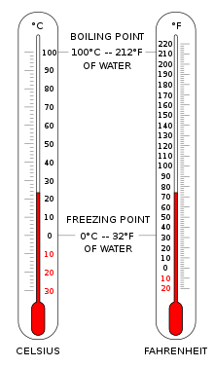
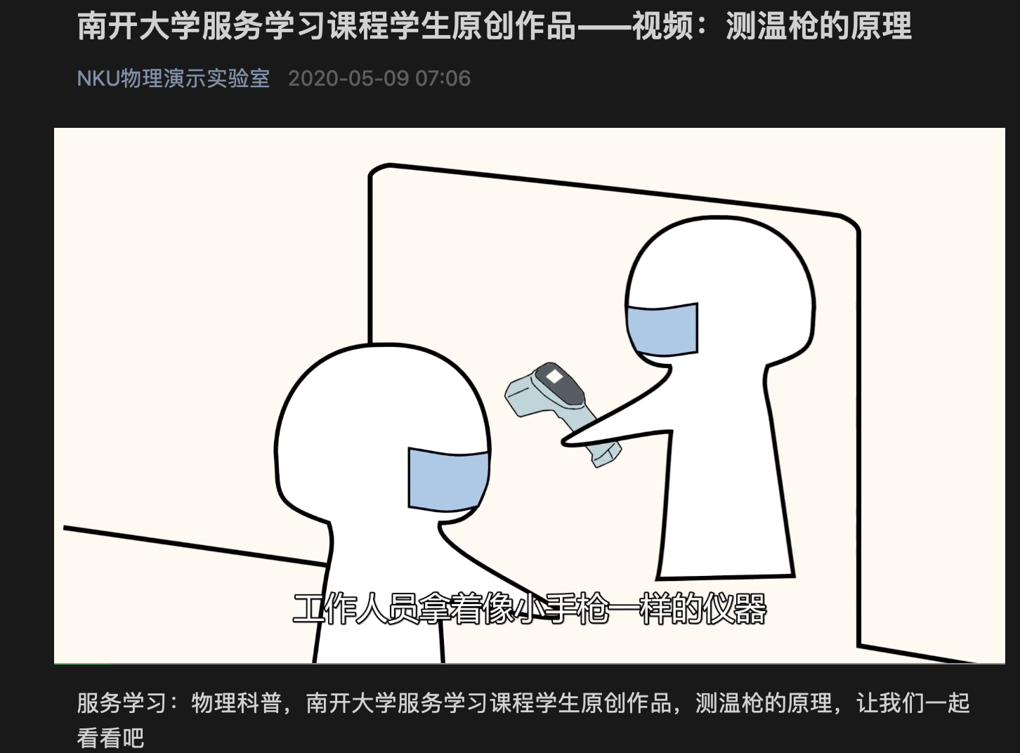
念奴娇·昆仑
毛泽东
横空出世，莽昆仑，阅尽人间春色。
飞起玉龙三百万，搅得周天寒彻。
夏日消溶，江河横溢，人或为鱼鳖。
千秋功罪，谁人曾与评说？
而今我谓昆仑：不要这高，不要这多雪。
安得倚天抽宝剑，把汝裁为三截？
一截遗欧，一截赠美，一截还东国。
太平世界，环球同此凉热。

Slide 3
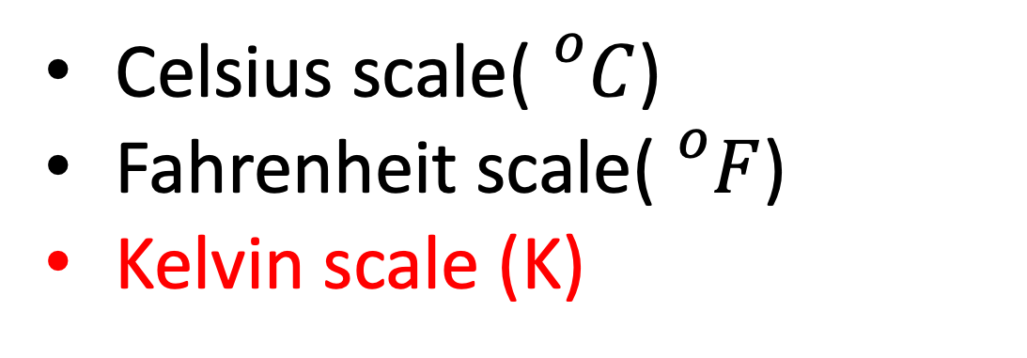
温标
Celsius scale(${}_{}^{o}C$)
Fahrenheit scale(${}_{}^{o}F$)
Kelvin scale (K)
0 K -273.15 C -459.67 F
第三个大作业
物理上严格的温度是通过热力学温标定义的，请给出这一定义；现行的国际温标为了便于实现，采用了分段的定义方法，请具体总结每一段的实现方法。
Absoulte Zero!!!

Slide 4
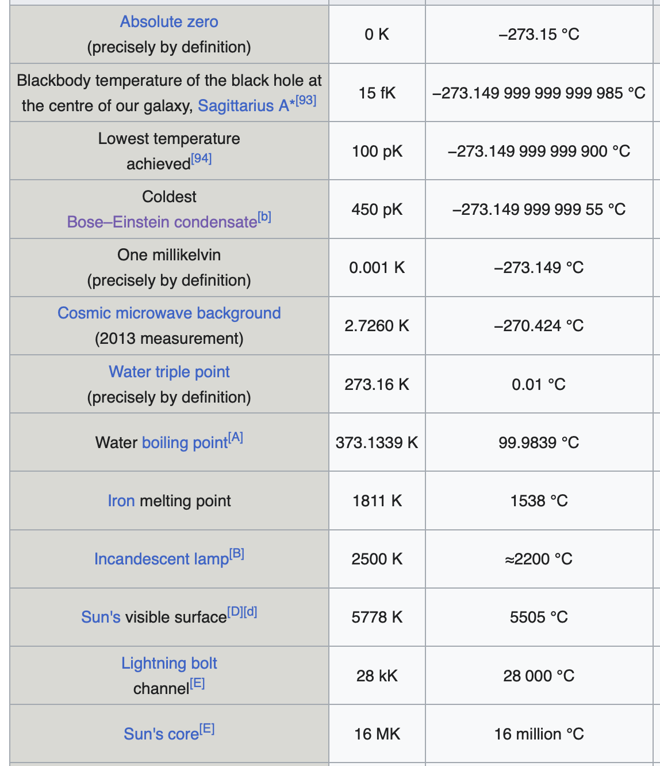
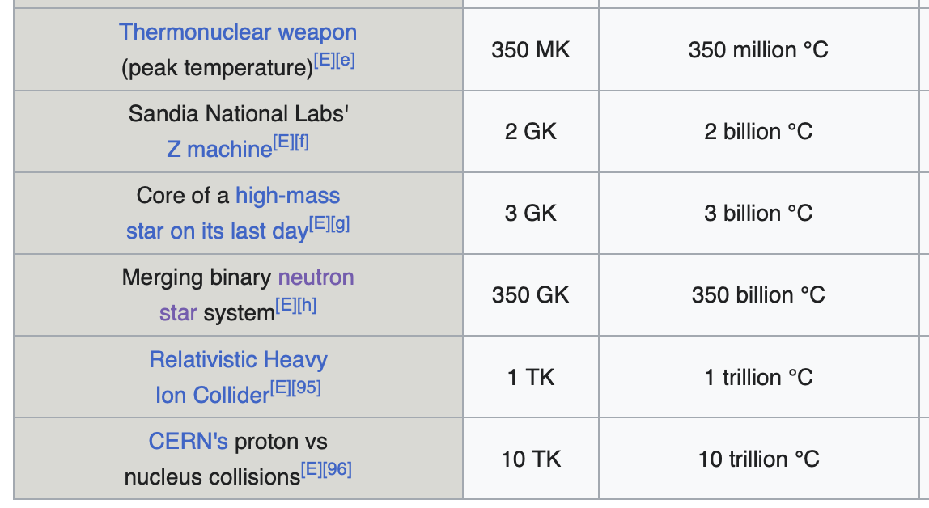

Slide 5
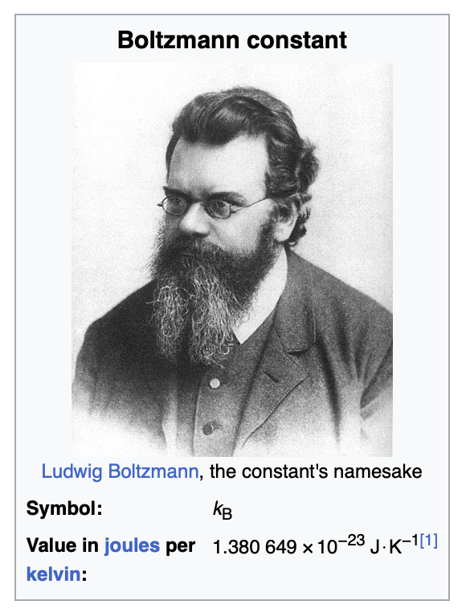
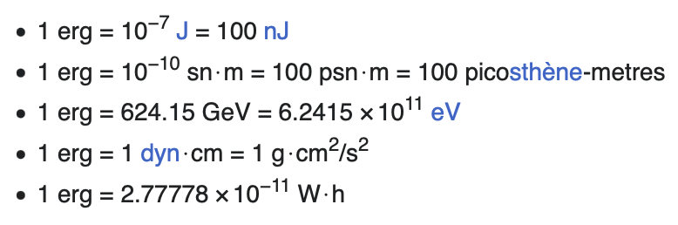


等概率原理、热接触、热平衡、最概然组态。。。
定义
$$\frac{1}{τ}={\left(\frac{∂ σ}{∂ U}\right)}_{N}$$
Fundamental temperature
$$τ=k_{B} T$$
能量量纲

Slide 6
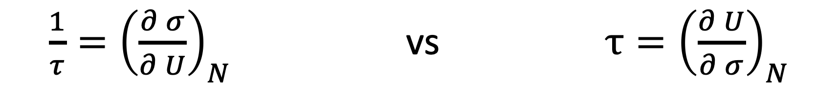
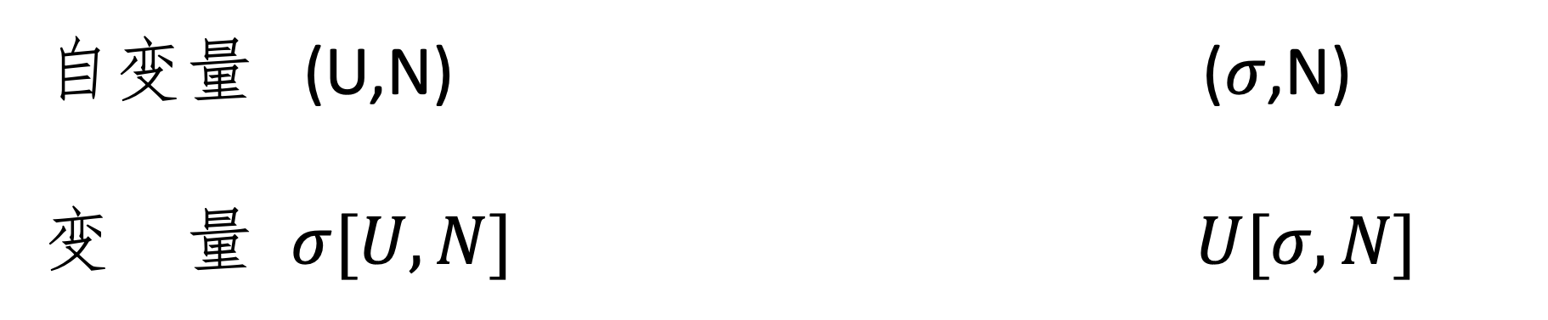
$\frac{1}{τ}={\left(\frac{∂ σ}{∂ U}\right)}_{N}$ vs $τ={\left(\frac{∂ U}{∂ σ}\right)}_{N}$
自变量 (U,N) ($σ$,N)
变 量 $σ[U,N]$ $U[σ,N]$
The question “what are the independent variables?” arises frequently in thermal physics because in some experiments we control some variables, and in other experiments we control other variables.

Slide 7
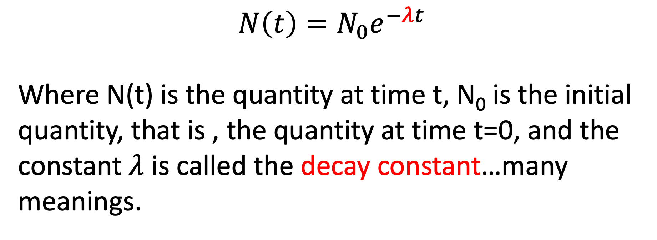
补遗
Exponential decay
$$N\left(t\right)=N_{0}e^{−λt}$$
Where N(t) is the quantity at time t, N₀ is the initial quantity, that is , the quantity at time t=0, and the constant $λ$ is called the decay constant…many meanings.

Slide 8
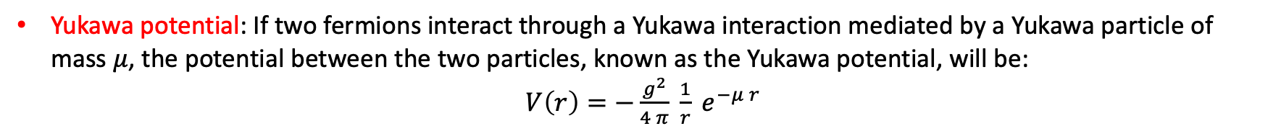
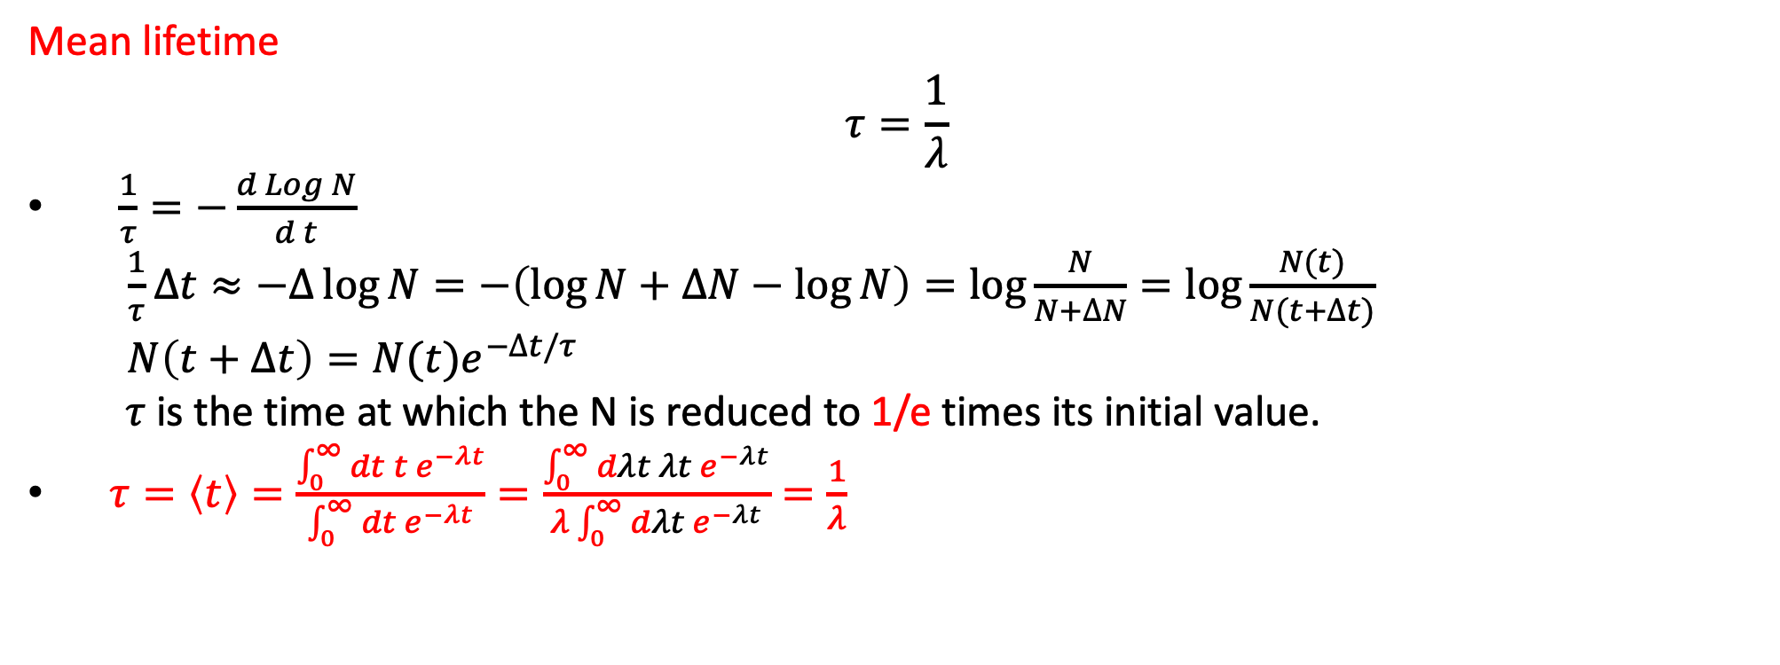
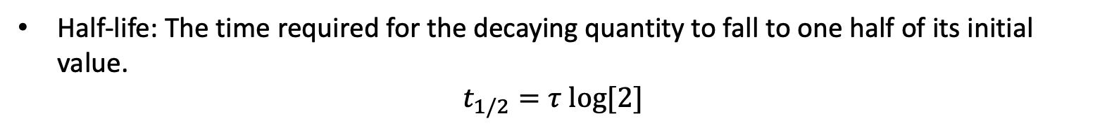
Mean lifetime
$$τ=\frac{1}{λ}$$
$\frac{1}{τ}=−\frac{d Log N}{d t}$
$\frac{1}{τ}∆t≈−∆\log{N=−\left(\log{N+∆N−\log{N}}\right)=\log{\frac{N}{N+∆N}=\log{\frac{N(t)}{N(t+∆t)}}}}$
$N\left(t+∆t\right)=N(t)e^{−∆t/τ}$
$τ$ is the time at which the N is reduced to 1/e times its initial value.
$τ=\left\langle t\right\rangle =\frac{\int_{0}^{∞}{dt t e^{−λt}}}{\int_{0}^{∞}{dt e^{−λt}}}=\frac{\int_{0}^{∞}{dλt λt e^{−λt}}}{λ\int_{0}^{∞}{dλt e^{−λt}}}=\frac{1}{λ}$
e=2.72
Half-life: The time required for the decaying quantity to fall to one half of its initial value.
$t_{1/2}=τ log⁡[2]$
Yukawa potential: If two fermions interact through a Yukawa interaction mediated by a Yukawa particle of mass $μ$, the potential between the two particles, known as the Yukawa potential, will be:
$V\left(r\right)=−\frac{g^{2}}{4 π} \frac{1}{r} e^{−μ r}$

Slide 9

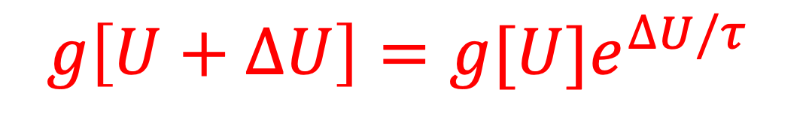

$$\frac{1}{τ}={\left(\frac{∂ σ}{∂ U}\right)}_{N}$$
简单推导
$$N\left(t+∆t\right)=N(t)e^{−∆t/τ}$$
$$g\left[U+∆U\right]=g[U]e^{∆U/τ}$$
温度: 使Multiplicity增加e倍所需要的能量

Slide 10
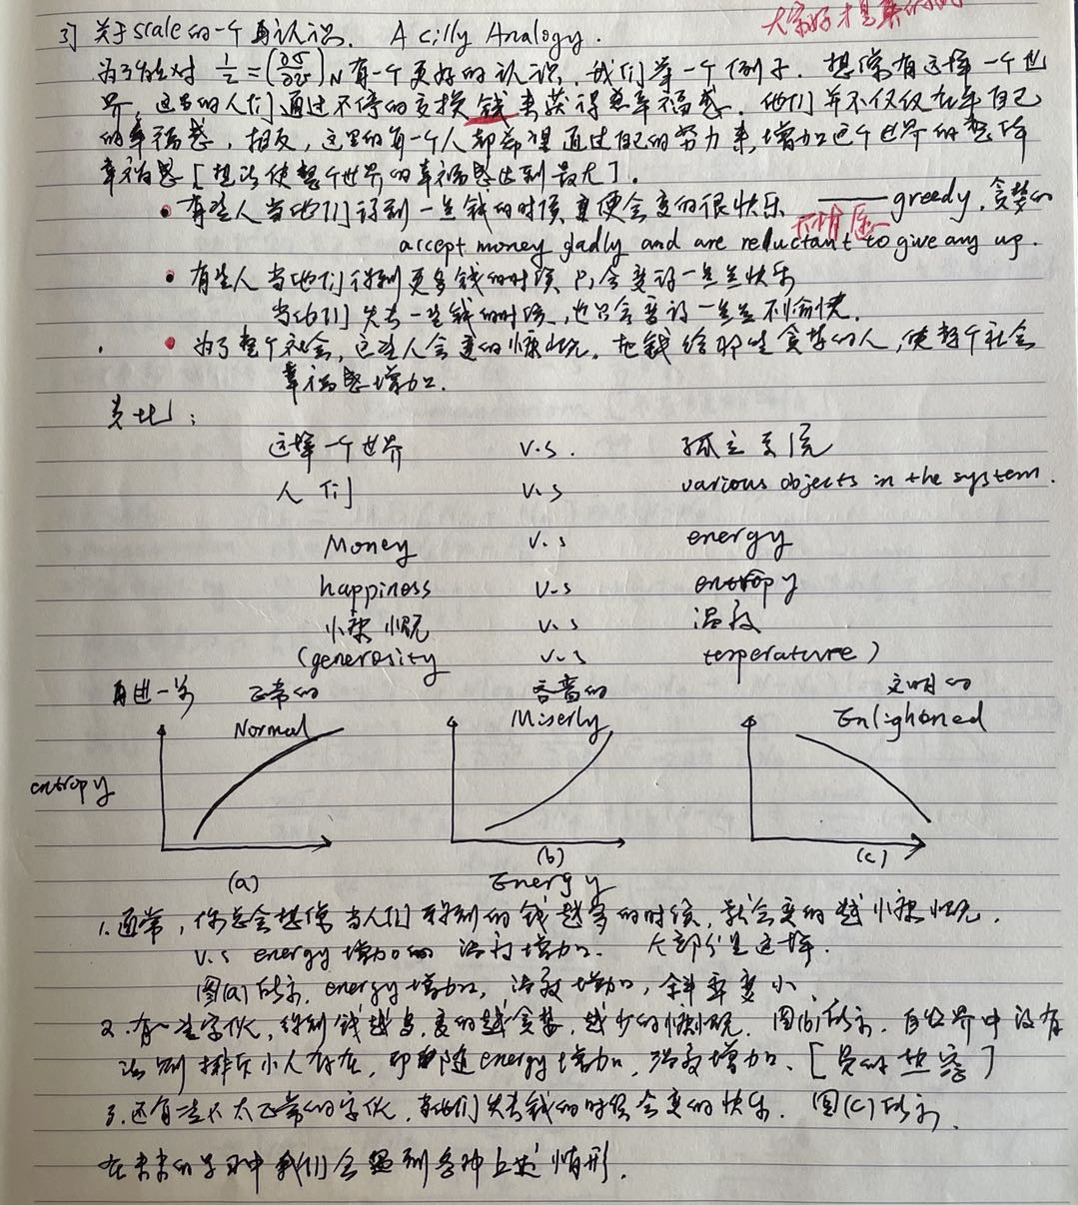
板书！

Slide 11

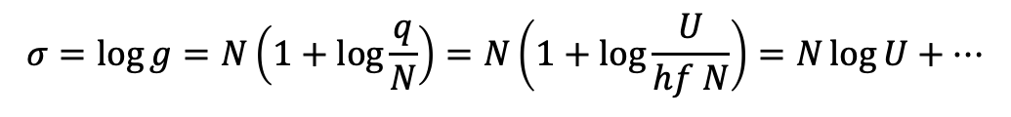
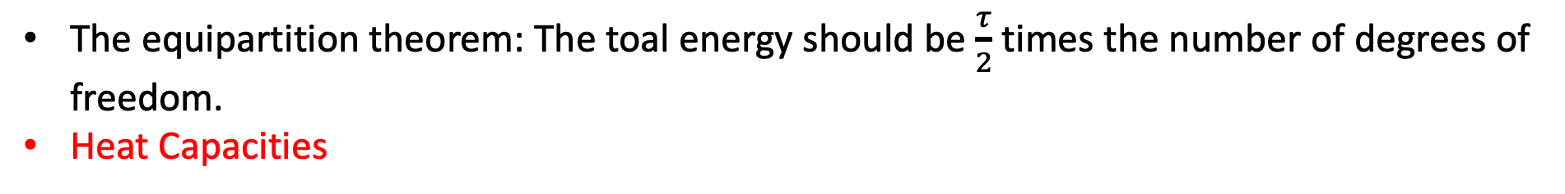




Real-world Example
$$U→σ[U]→τ[U]$$
$$g={\left(\frac{eq}{N}\right)}^{N}$$
考虑爱因斯坦固体:
$$g=f(N){\left(V\right)}^{N}U^{3N/2}$$
考虑理想气体:
$$σ=\log{g=N\left(1+\log{\frac{q}{N}}\right)=N\left(1+\log{\frac{U}{hf N}}\right)=N\log{U+…}}$$
$$σ=\log{g=\frac{3N}{2}\log{U+…}}$$
$$\frac{1}{τ}={\left(\frac{∂ σ}{∂ U}\right)}_{N}=\frac{N}{U}$$
$$\frac{1}{τ}={\left(\frac{∂ σ}{∂ U}\right)}_{N}=\frac{\frac{3}{2}N}{U}$$
$$U=\frac{3}{2}Nτ$$
$$U=Nτ$$
The equipartition theorem: The toal energy should be $\frac{τ}{2}$ times the number of degrees of freedom.
Heat Capacities

Slide 12
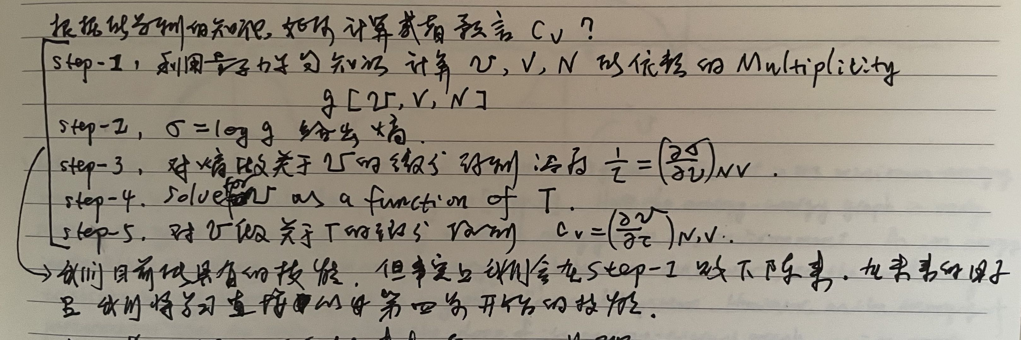
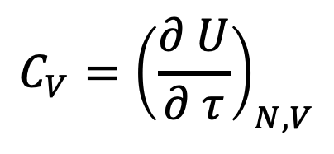

$$C_{V}={\left(\frac{∂ U}{∂ τ}\right)}_{N,V}$$
热容
爱因斯坦固体: $C_{V}=N$
理想气体:$C_{V}=\frac{3}{2}N$

Slide 13
我们举一个例子走一遍step1 到 step5
见Mathematica文件热容.nb

Slide 14
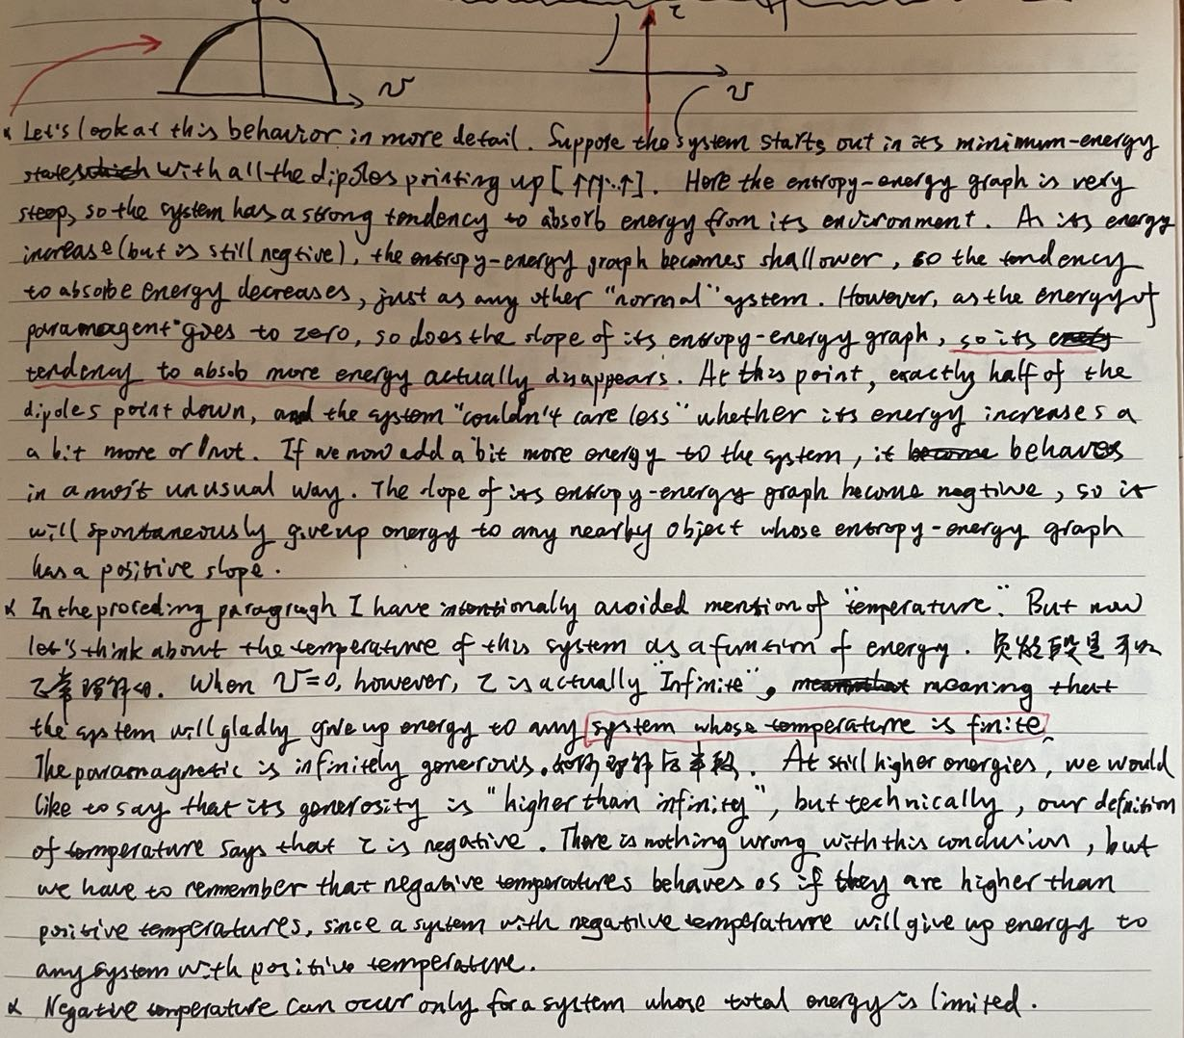
板书！

Slide 15
Mesure Entropy
热容量是用宏观方法探究微观奥秘的探针——赵柳书后记

Slide 16
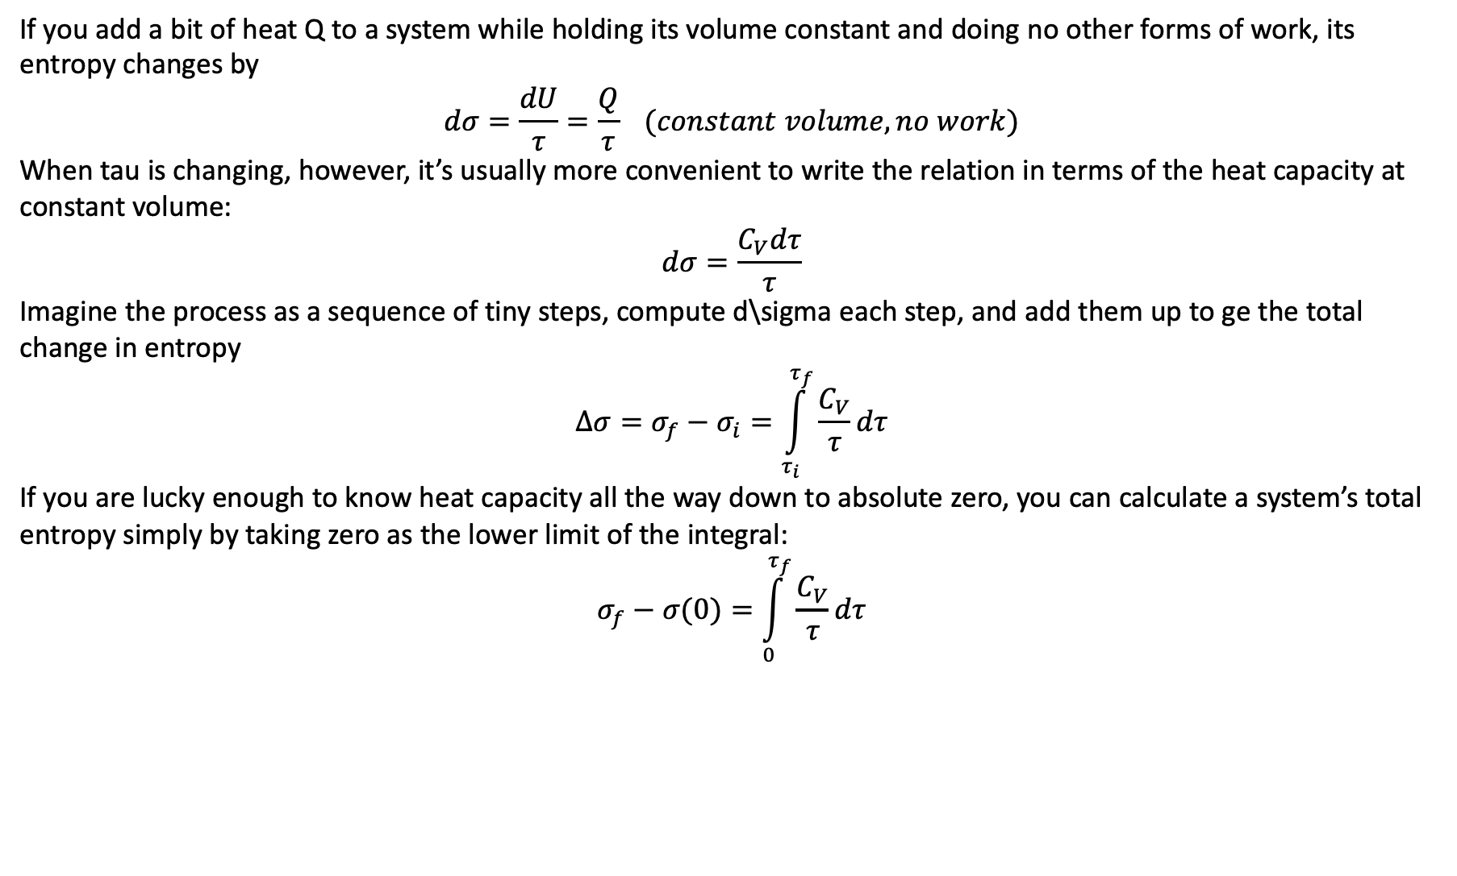
Mesure Entropy
If you add a bit of heat Q to a system while holding its volume constant and doing no other forms of work, its entropy changes by
$$dσ=\frac{dU}{τ}=\frac{Q}{τ} (constant volume, no work)$$
When tau is changing, however, it’s usually more convenient to write the relation in terms of the heat capacity at constant volume:
$$dσ=\frac{C_{V}dτ}{τ}$$
Imagine the process as a sequence of tiny steps, compute d\sigma each step, and add them up to ge the total change in entropy
$$∆σ=σ_{f}−σ_{i}=\int_{τ_{i}}^{τ_{f}}{\frac{C_{V}}{τ}dτ}$$
If you are lucky enough to know heat capacity all the way down to absolute zero, you can calculate a system’s total entropy simply by taking zero as the lower limit of the integral:
$$σ_{f}−σ(0)=\int_{0}^{τ_{f}}{\frac{C_{V}}{τ}dτ}$$

Slide 17
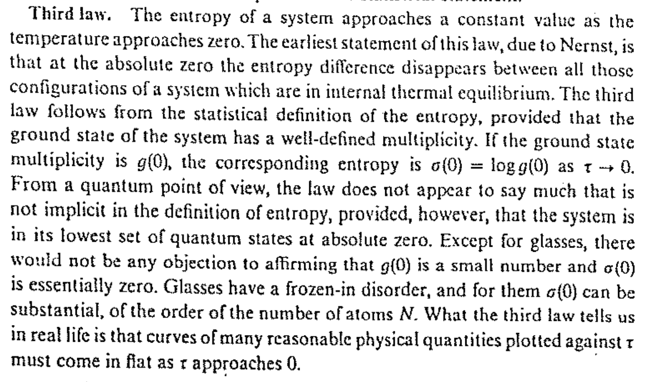
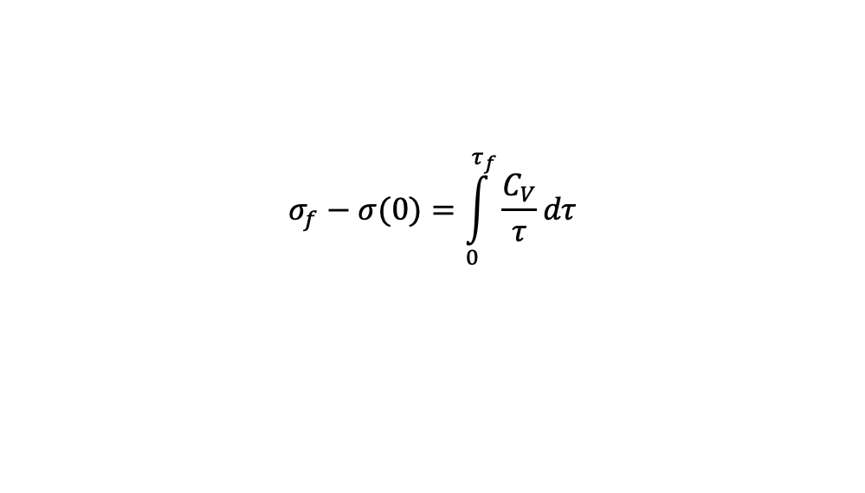
$$σ_{f}−σ(0)=\int_{0}^{τ_{f}}{\frac{C_{V}}{τ}dτ}$$
At zero temperature a system should settle into its unique lowest-energy state, g=0, and then $σ\left(0\right)=0$;???
$C_{V}→0 as τ→0$

Slide 18
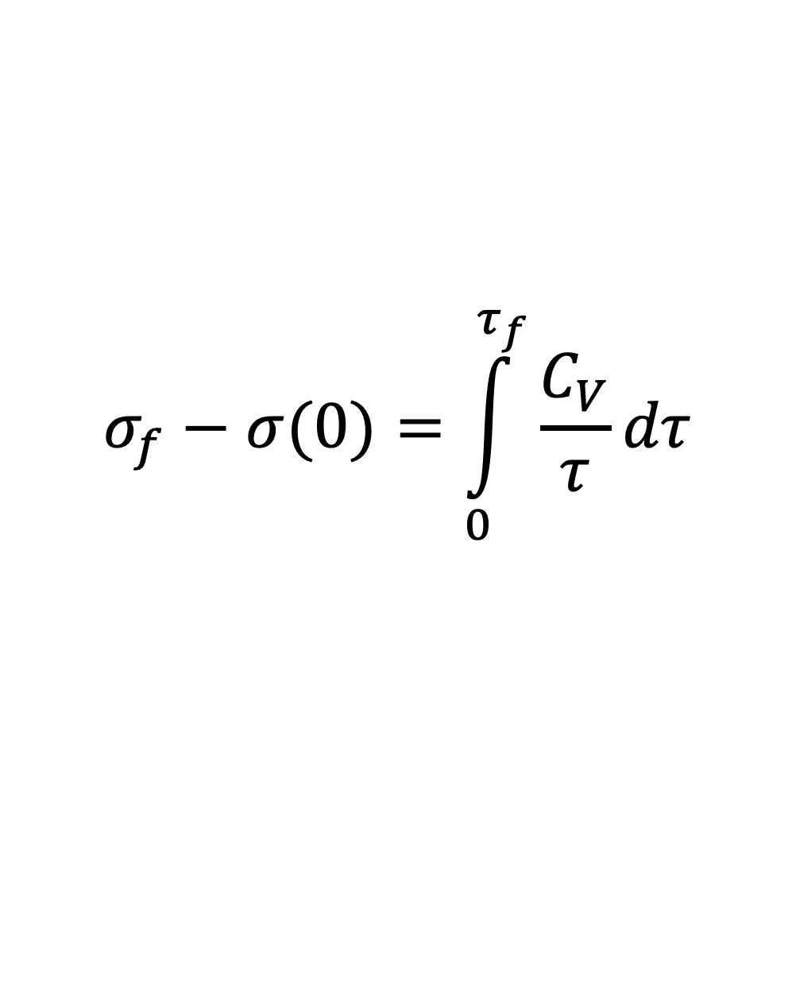
$$σ_{f}−σ(0)=\int_{0}^{τ_{f}}{\frac{C_{V}}{τ}dτ}$$
2022.02.27

Slide 19
热物（第三四周）
Boltzman Factor
$$g→σ→τ→C_{V}$$
本次课关注一个这样的系统，它和热库进行热接触达到热平衡，获得固定的温度后，如何考量系统处于某特定微观态的概率。

Slide 20
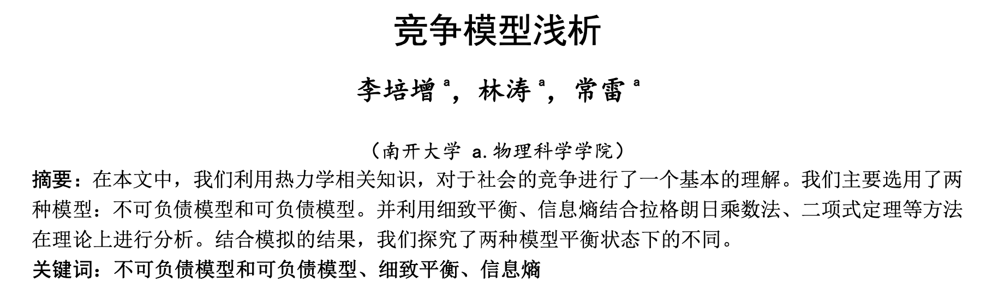
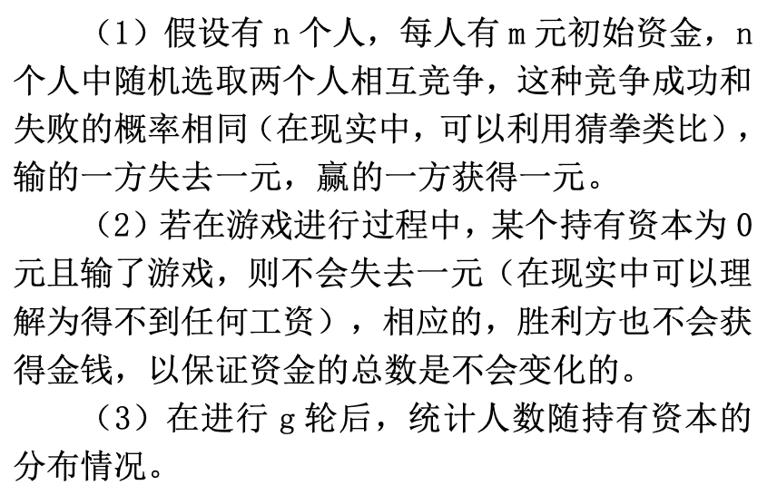
一个游戏(林秀豪视频课)

Slide 21
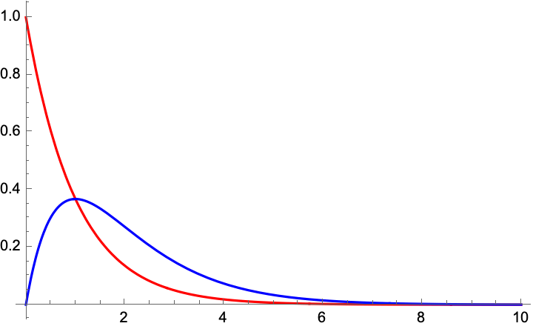
一个游戏(林秀豪视频课，孟祥谦同学讲解)
初始状态：多少人，每人多少钱
猜结果：
?

Slide 22
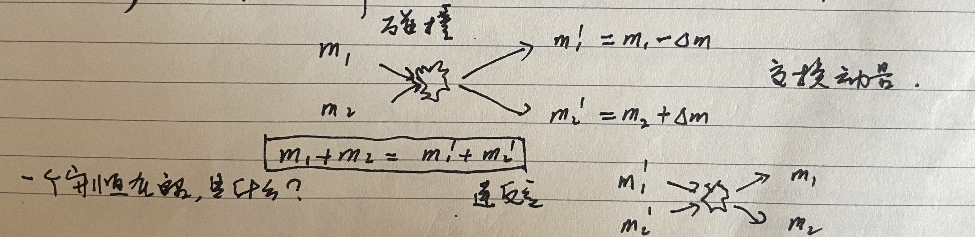
解释游戏（不讲）
Why
细致平衡
微观随机过程的可逆性
$P\left(m_{1}\right)P($ $m_{2})=P\left(m_{1}^{′}\right)P(m_{2}^{′} )$
指数！！！
The principle of detailed balance was explicitly introduced for collisions by L. Boltzmann.
Einstein in 1916 used the principle of detailed balance in a background for this quantum theory of emission and absorption of radiation.
…

Slide 23
Why
编外：信息熵初探

Slide 24
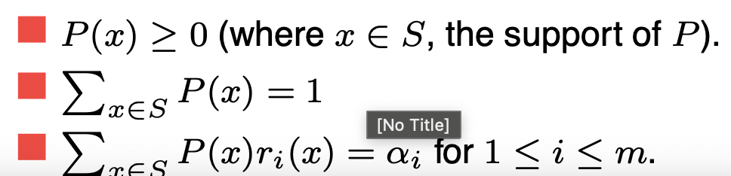
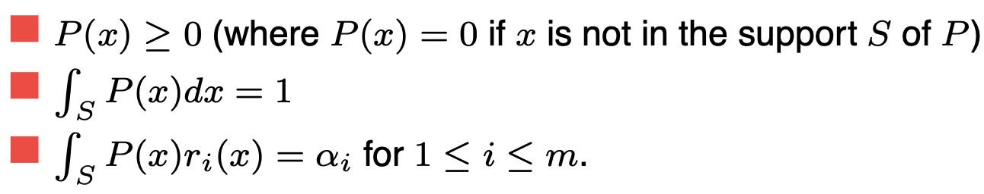
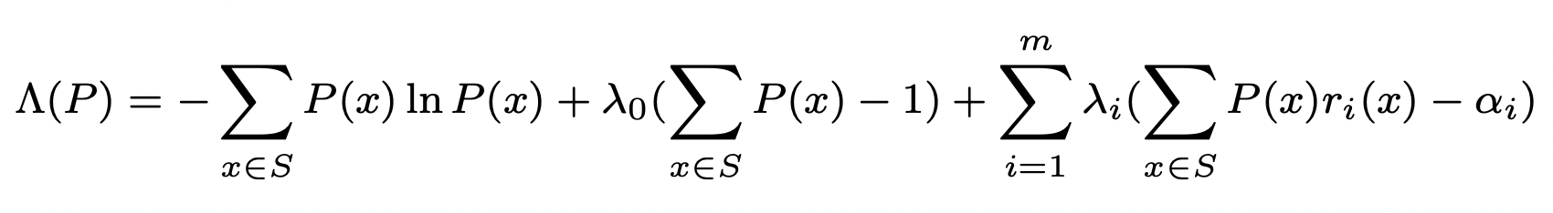
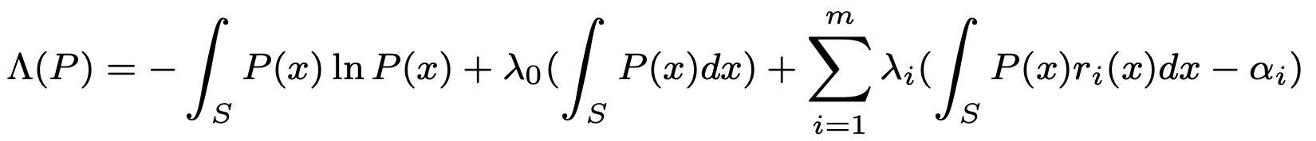
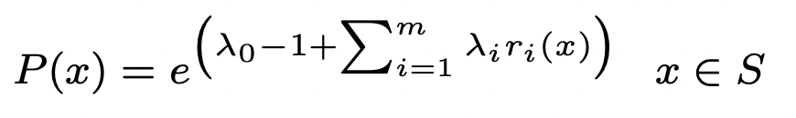
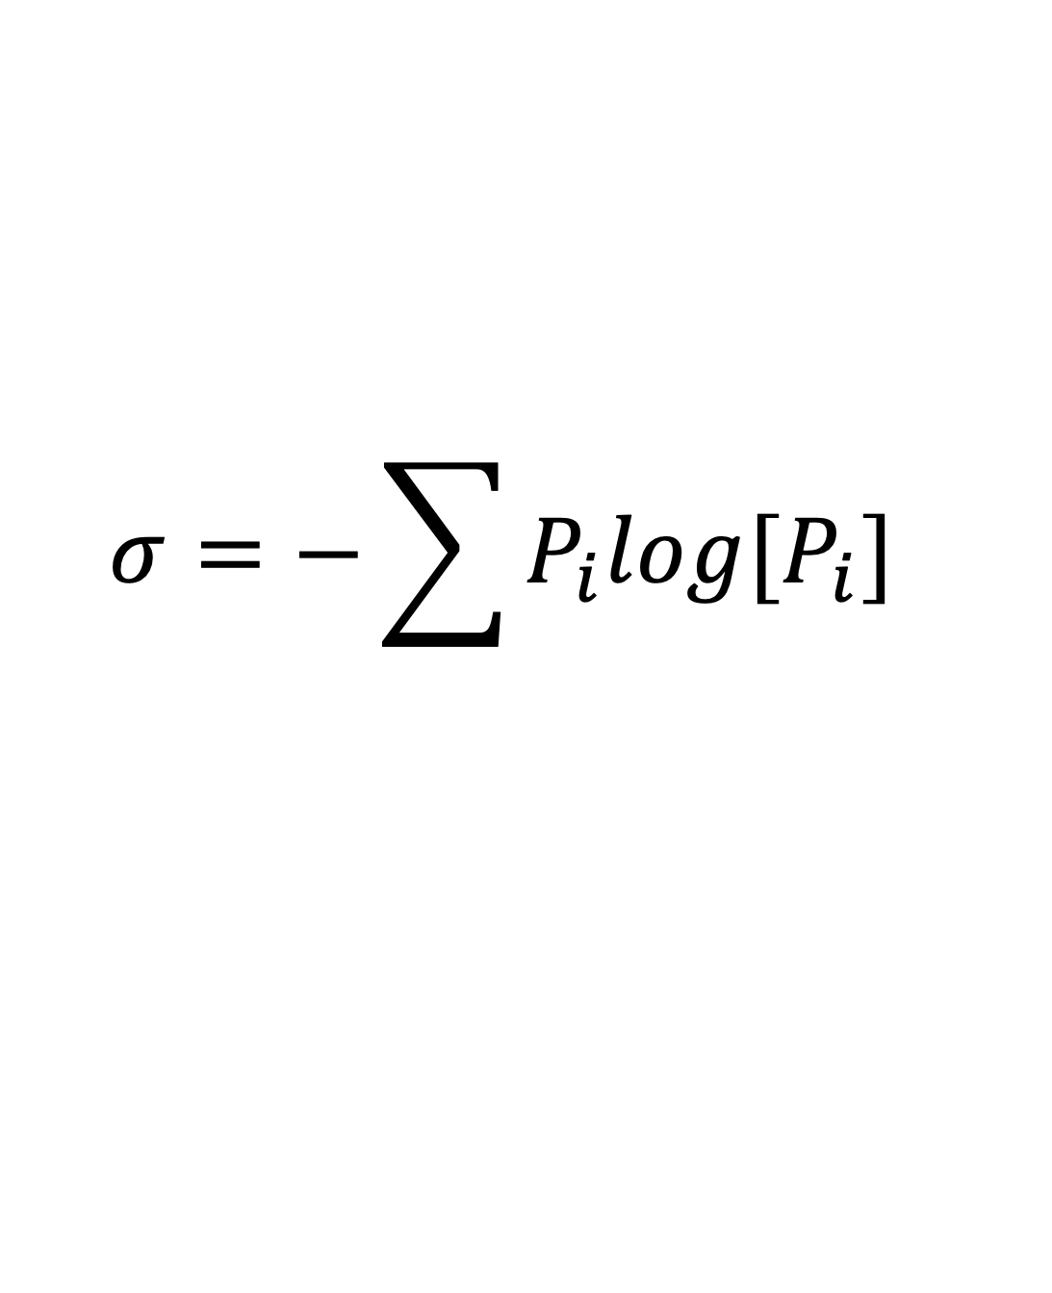
$$σ=−\sum{P_{i}log[P_{i}]}$$
-1
拉格朗日乘数法（约束条件下的极值问题）
观测几个特殊分布

Slide 25
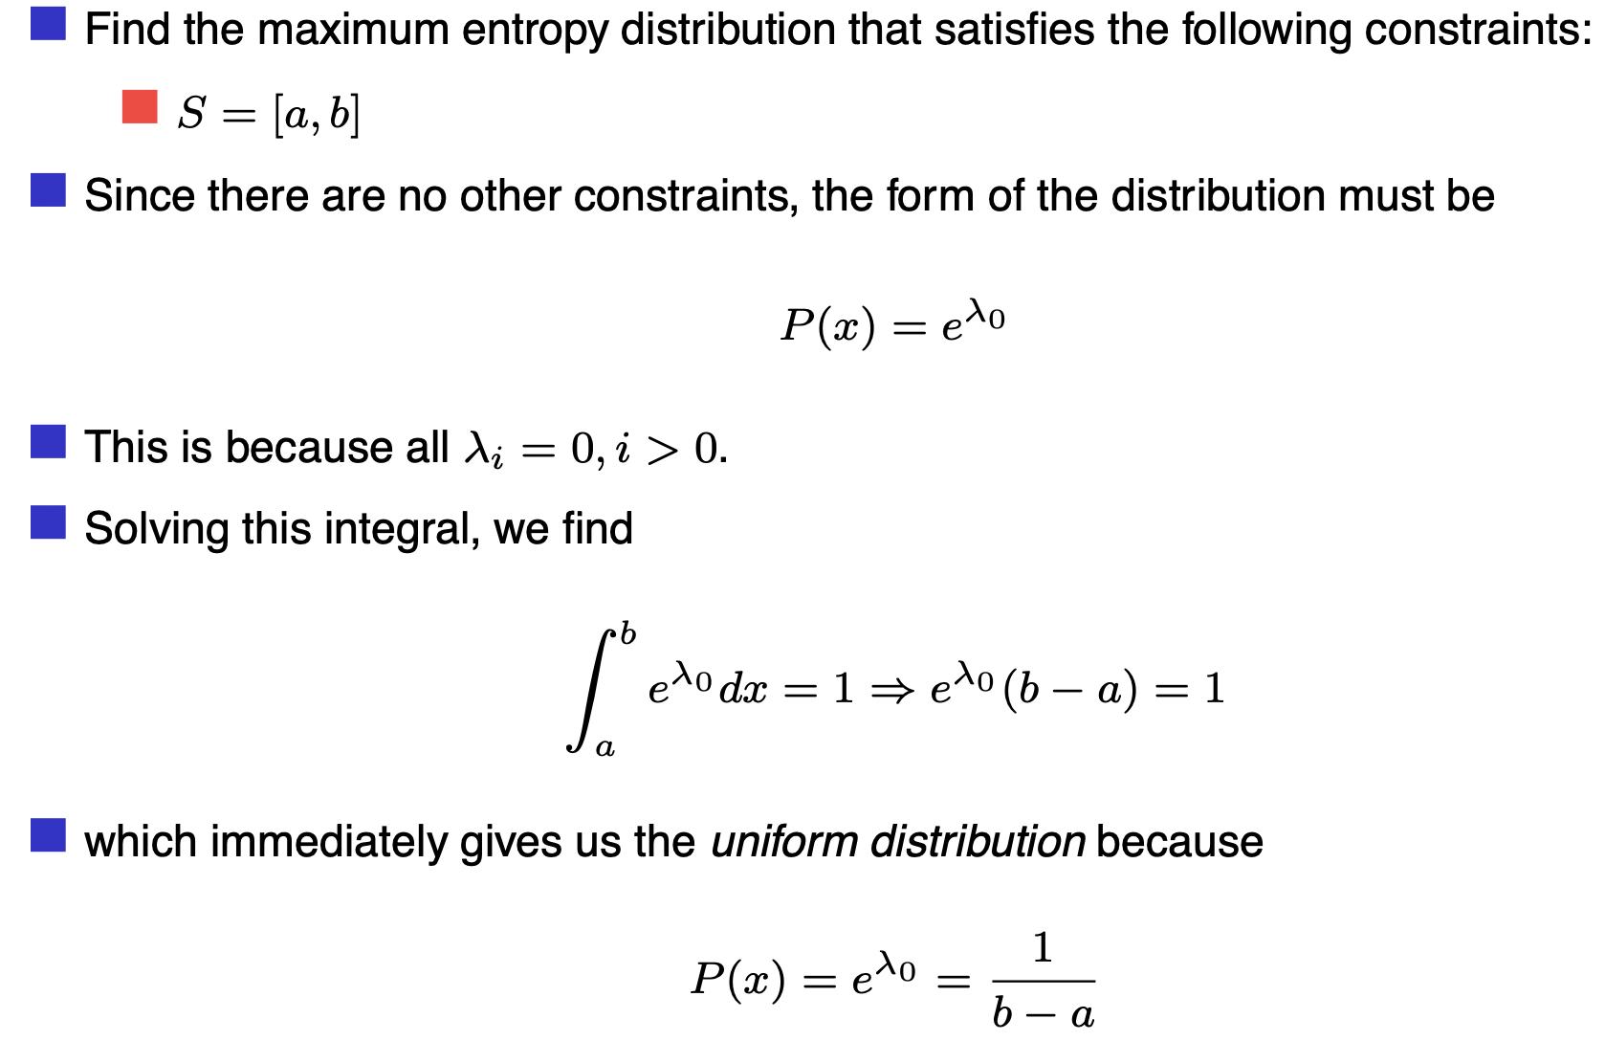

Slide 26
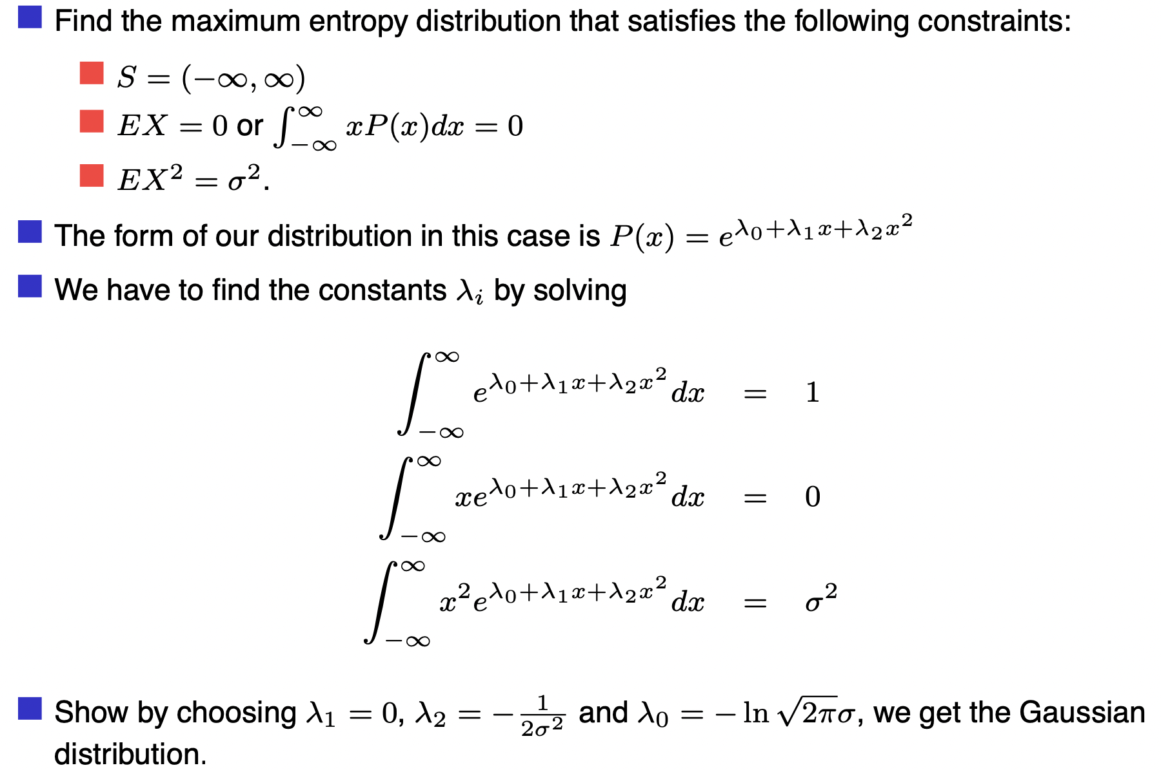

Slide 27
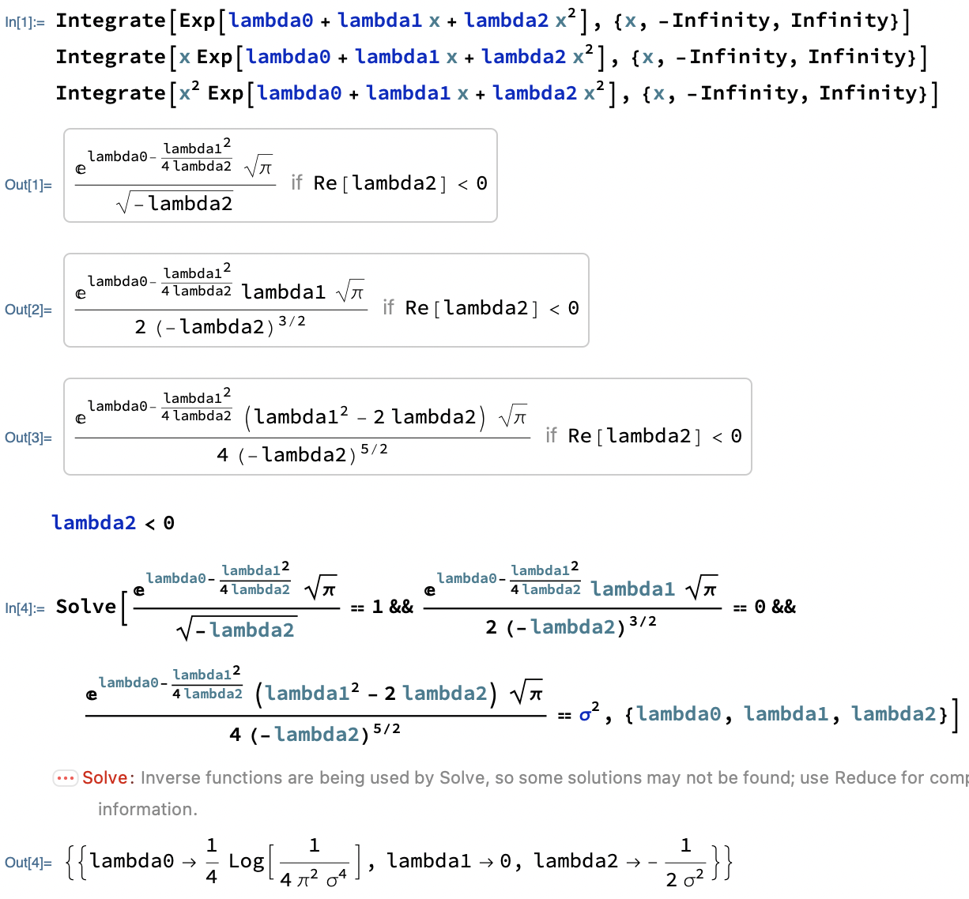
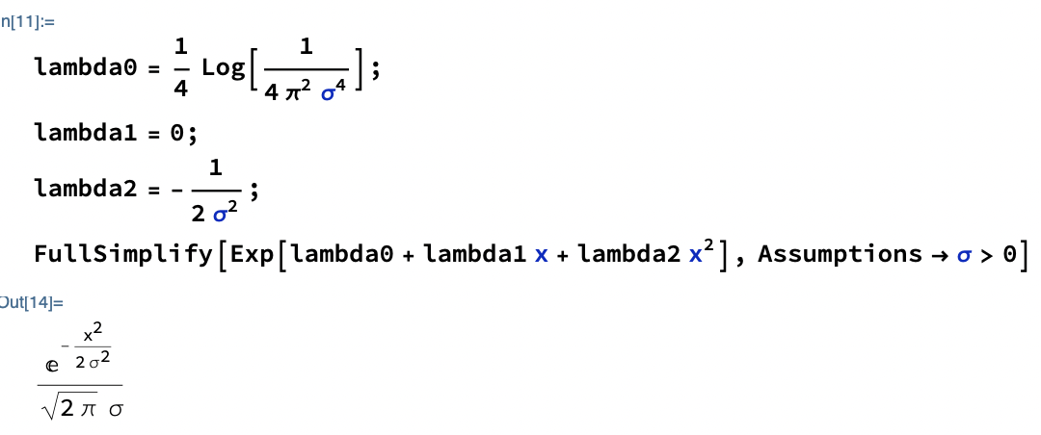

Slide 28
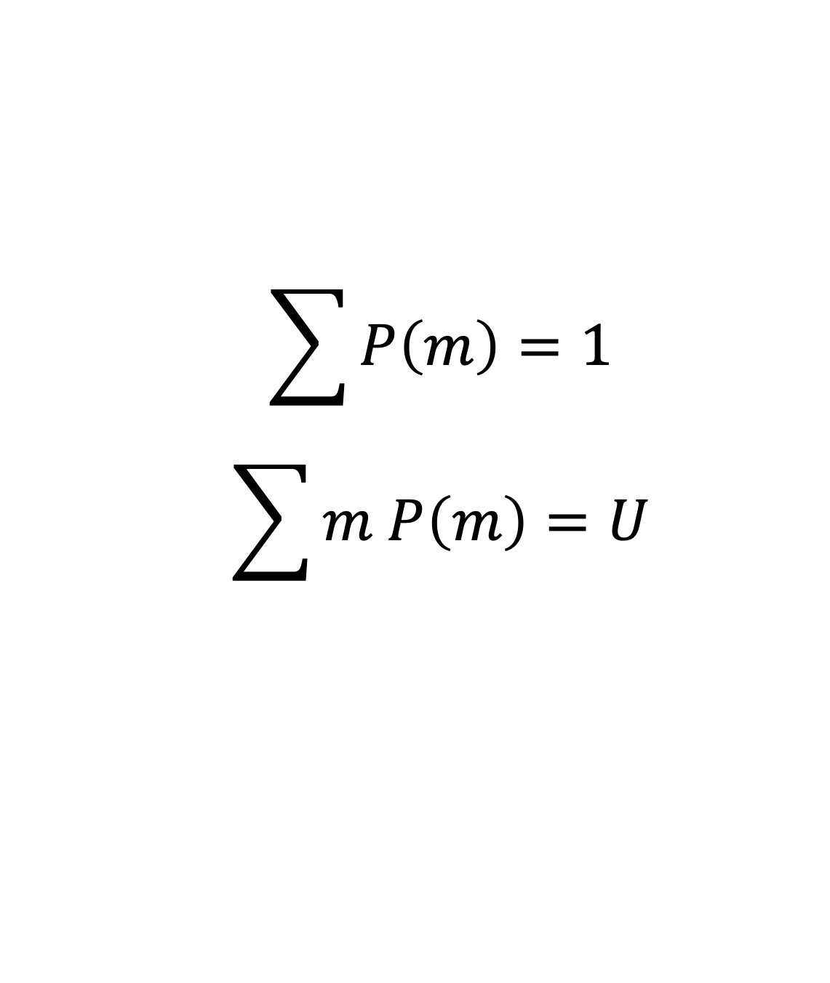
解释游戏
约束条件
$$\sum{P\left(m\right)=1}$$
$$\sum{m P\left(m\right)=U}$$
高斯（钱少的人多？？？）

Slide 29
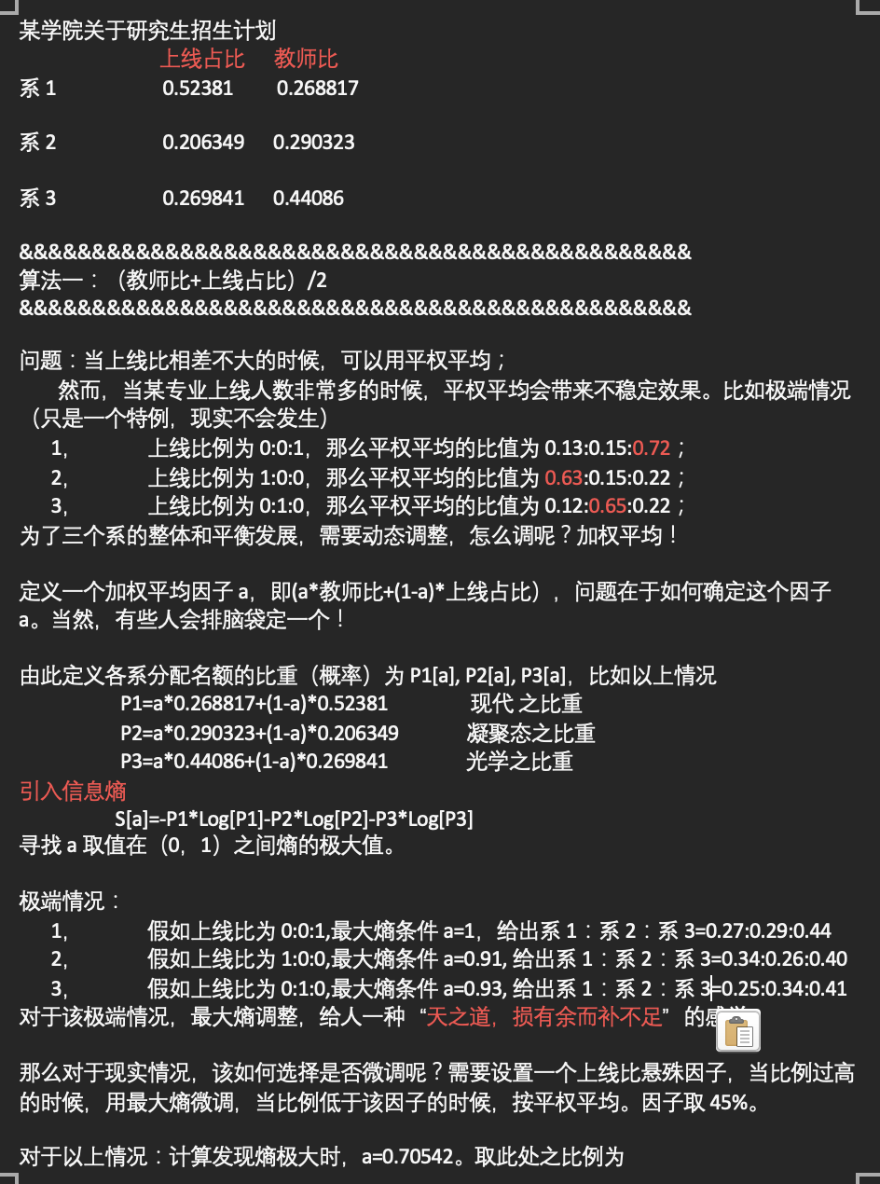

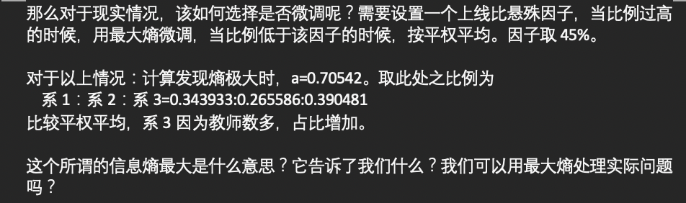
关于信息熵的一个例子（自设）
信息熵极大

Slide 30
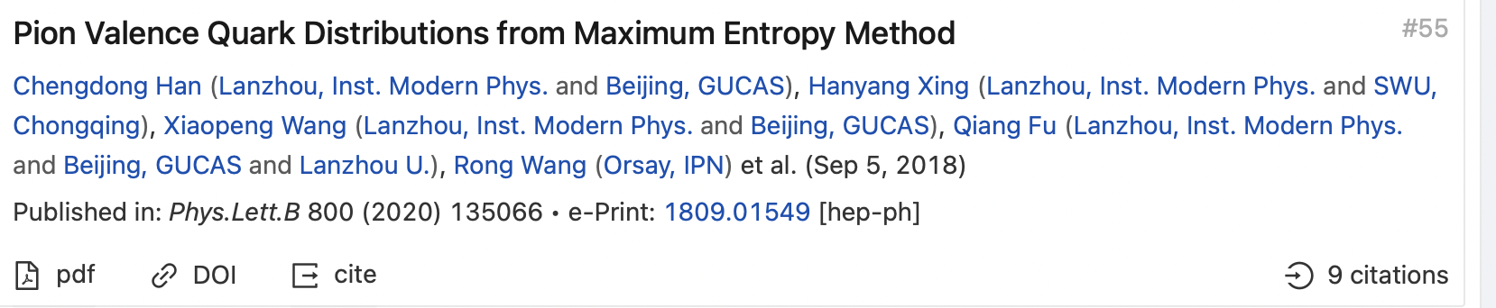
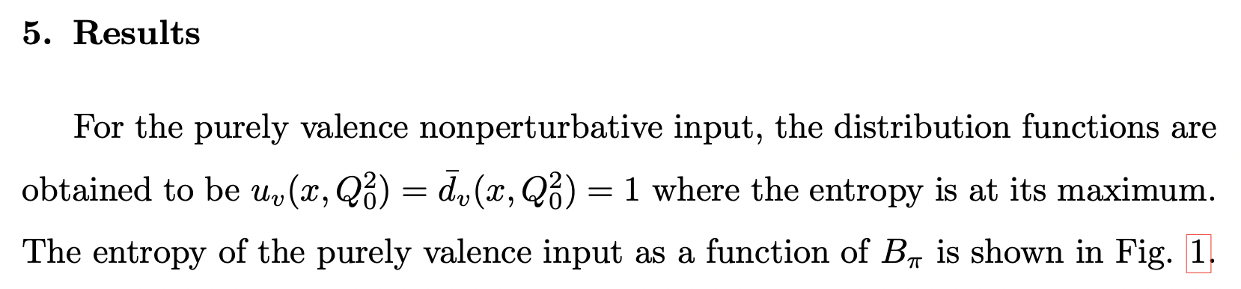

另外一个畅想
$$S∈\left[0,1\right]$$
$$P\left[x\right]=P\left[1−x\right]$$
$$P\left[x\right]→{\left(1−x\right)}^{2} when x→1$$

Slide 31

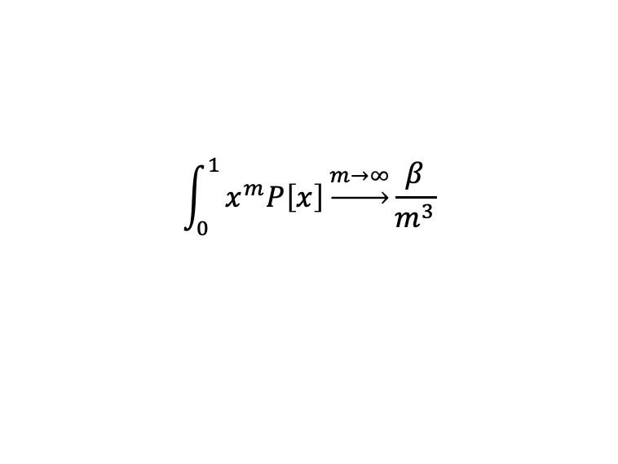
另外一个畅想
$$S∈\left[0,1\right]$$
$$P\left[x\right]=P\left[1−x\right]$$
$$P\left[x\right]→{\left(1−x\right)}^{2} when x→1$$
$$\int_{0}^{1}{x^{m}P\left[x\right]\underset{→}{m→∞}\frac{β}{m^{3}}}$$
$$P\left[x\right]=e^{λ_{0}−1+λ_{m}x^{m}}$$
需要更进一步思考

Slide 32

回到热物！
热库，$U_{R}$

Slide 33

回到热物，从基本假设出发
什么是热库？
一个毫无特色的家伙
热库，$U_{R}$
系统
E

Slide 34
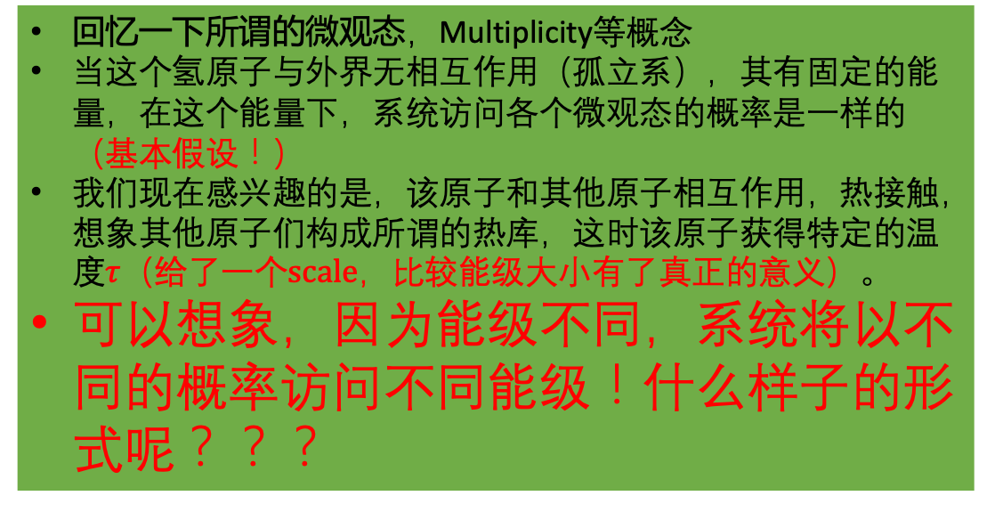

考虑单个氢原子
不考虑自旋！
energy
-3.4ev
热库，$U_{R}$
回忆一下所谓的微观态，Multiplicity等概念
当这个氢原子与外界无相互作用（孤立系），其有固定的能量，在这个能量下，系统访问各个微观态的概率是一样的（基本假设！）
我们现在感兴趣的是，该原子和其他原子相互作用，热接触，想象其他原子们构成所谓的热库，这时该原子获得特定的温度$τ（给了一个scale，比较能级大小有了真正的意义）$。
可以想象，因为能级不同，系统将以不同的概率访问不同能级！什么样子的形式呢？？？
-13.6ev

Slide 35
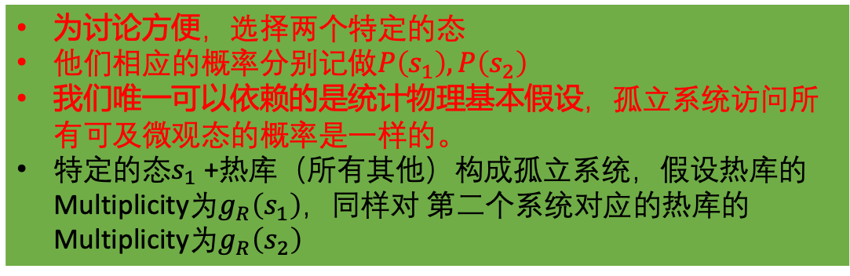


考虑单个氢原子
不考虑自旋
energy
-3.4ev
热库，$U_{R}$
$$s_{2}…ε(s_{2})$$
为讨论方便，选择两个特定的态
他们相应的概率分别记做$P\left(s_{1}\right),P\left(s_{2}\right)$
我们唯一可以依赖的是统计物理基本假设，孤立系统访问所有可及微观态的概率是一样的。
特定的态$s_{1}$+热库（所有其他）构成孤立系统，假设热库的Multiplicity为$g_{R}\left(s_{1}\right)，同样对$ 第二个系统对应的热库的Multiplicity为$g_{R}\left(s_{2}\right)$
-13.6ev
$$s_{1}…ε(s_{1})$$

Slide 36
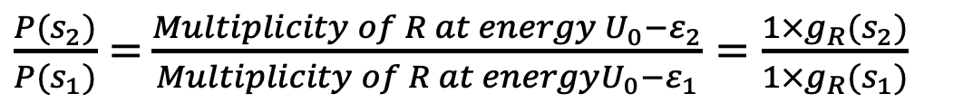
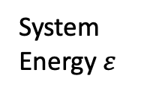
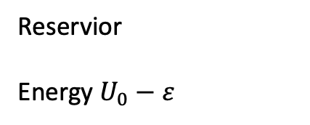
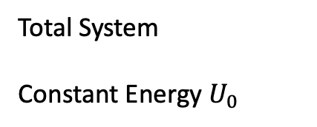

利用基本假设我们有
$\frac{P(s_{2})}{P(s_{1})}=$ $\frac{Multiplicity of R at energy U_{0}−ε_{2}}{Multiplicity of R at energyU_{0}−ε_{1}}=\frac{1×g_{R}(s_{2})}{1×g_{R}(s_{1})}$
Reservior
Energy $U_{0}−ε$
热库，$U_{R}$
Total System
Constant Energy $U_{0}$
System
Energy $ε$
用熵来表达
$$\frac{P(s_{2})}{P(s_{1})}=\frac{e^{σ_{R}( s_{2}) }}{e^{σ_{R}( s_{1}) }}=e^{σ_{R}\left( s_{2}\right)−σ_{R}( s_{1})}$$

Slide 37



系统能量相对于总能量是一个小量，做Taylor展开
$$σ_{R}\left(U_{0}−ε\right)=σ_{R}\left(U_{0}\right)−{\left(\frac{∂ σ_{R}}{∂ U}\right)}_{V,N,…}ε+…$$
温度定义
系统温度和热库温度一样
$$\frac{P(s_{2})}{P(s_{1})}=\frac{e^{σ_{R}( s_{2}) }}{e^{σ_{R}( s_{1}) }}=e^{σ_{R}\left( s_{2}\right)−σ_{R}( s_{1})}=\frac{e^{−ε2/τ}}{e^{−ε1/τ}}$$
$$\frac{P(s_{1})}{e^{−ε1/τ}}=\frac{P(s_{2})}{e^{−ε2/τ}}$$

Slide 38



改写一下
$\frac{P(s_{1})}{e^{−ε1/τ}}=\frac{P(s_{2})}{e^{−ε2/τ}}$=… $\frac{P(s_{n})}{e^{−εn/τ}}=常数=Z$
$$P\left(s\right)=\frac{1}{Z}e^{−ε/τ}$$
访问s态的概率
Boltzman Factor
Partition Function(配分函数)
$$ε>τ$$
$$ε<τ$$
$$1=\sum_{s}{P\left(s\right)=\frac{1}{Z}\sum_{s}{Boltzman Factor }}$$
Patition Function=sum of all Boltzman Factor

Slide 39


$$P\left(s\right)=\frac{1}{Z}e^{−ε_{s}/τ}$$
Boltzman Factor
Partition Function(配分函数)
$$1=\sum_{s}{P\left(s\right)=\frac{1}{Z}\sum_{s}{Boltzman Factor }}$$
Partition Function=sum of all Boltzman Factor
平均值
能量均分定理
麦克斯韦速率分布

Slide 40
平均值
能量均分定理
麦克斯韦速率分布

Slide 41


平均值
在某时刻，2个原子处于0ev，2个处于4ev，1个处于7ev
平均能量
$$\overline{E}=\frac{\left(0ev\right)×2+\left(4ev\right)×2+(7ev)×1}{5}=3ev (相加除以5)$$
另外一种思路
$\overline{E}=\left(0ev\right)\frac{2}{5}+\left(2ev\right)\frac{2}{5}+\left(7ev\right)\frac{1}{5}=3ev$ (分配后相加)
the energy of each state is multiplied by the probability of that state occurring
推广到一般形式
$$\overline{E}=\frac{\sum_{s}{E\left(s\right)N(s)}}{N}=\sum_{s}{E\left(s\right)\frac{N\left(s\right)}{N}=\sum_{s}{E\left(s\right)P(s)}}$$
7ev
4ev
推广一下
0ev
$$\overline{X}=\frac{1}{Z}\sum_{s}{X(s)e^{−ε(s)/τ}}$$

Slide 42

相加性(additive)
One nice feature of average values is that they are additive; for example, the average total energy of two objects is the sum of their individual average energies. This means that if you have a collection of many identical, independent particles, you can compute their total(average) energy from the average energy of just one, simply by multiplying by how many there are:
$$U=N\overline{E}$$

Slide 43


相加性

Slide 44


Q-1: Prove that, for any system in equilibrium with a reservoir at temperature tau, the average of the energy is
$$\overline{E}=τ^{2}\frac{∂}{∂ τ}\log{Z=}−\frac{∂}{∂ β}\log{Z}$$
Q-2: Energy fluctuation
$$\left\langle {\left(ε−\left\langle ε\right\rangle \right)}^{2}\right\rangle =τ^{2}{\left(\frac{∂ \left\langle ε\right\rangle }{∂ τ}\right)}_{V}$$
Q-3: Paramagnetism
$$g→σ→τ→U(τ)→C_{V}$$
对单个dipole的Partition Function
$$Z=e^{−μB/τ}+e^{μB/τ}$$
发现dipole朝上的概率
$$P_{↑}=\frac{e^{μB/τ}}{e^{−μB/τ}+e^{μB/τ}}$$
发现dipole朝下的概率
$$P_{↓}=\frac{e^{−μB/τ}}{e^{−μB/τ}+e^{μB/τ}}$$
平均能量
$$\overline{E}=\left(−μB\right)P_{↑}+\left(μB\right)P_{↓}=−μB\tanh{\frac{μB}{τ}}=−\frac{∂}{∂ β}\log{Z}$$
平均磁矩
$$\overline{μ}=\left(μ\right)P_{↑}+(−μ)P_{↓}$$
$$\overline{X}=\frac{1}{Z}\sum_{s}{X(s)e^{−ε(s)/τ}}$$
N个dipole的话，total能量乘以N即可

Slide 45







Q-4: Rotation of Diatomic Molecules（双原子分子旋转）
$$ε\left(j\right)=j(j+1)ε$$
Where j can be 0,1,2, etc., and $ε$ is a constant that is inversely proportional to the molecule’s moment of inertia. The number of degenerate states for level j is 2j+1.
Partition Function
$Z=\sum_{j=0}^{∞}{(2j+1)e^{−j(j+1)ε/τ}}$
$$\frac{τ}{ε}=20$$
$$\frac{τ}{ε}=100$$
$$τ≫ε$$
求和变积分！！！
$$Z≈\int_{0}^{∞}{\left(2x+1\right)e^{−\frac{x\left(x+1\right)ε}{τ}}=\frac{τ}{ε}}$$

Slide 46

Q-4: Rotation of Diatomic Molecules（双原子分子旋转）
$$ε\left(j\right)=j(j+1)ε$$
Where j can be 0,1,2, etc., and $ε$ is a constant that is inversely proportional to the molecule’s moment of inertia. The number of degenerate states for level j is 2j+1.
Partition Function
$Z=\sum_{j=0}^{∞}{(2j+1)e^{−j(j+1)ε/τ}}$
$$\frac{τ}{ε}=20$$
$$\frac{τ}{ε}=100$$
$$τ≫ε$$
求和变积分！！！
$$Z≈\int_{0}^{∞}{\left(2x+1\right)e^{−\frac{x\left(x+1\right)ε}{τ}}=\frac{τ}{ε}}$$

Slide 47




$$\frac{τ}{ε}=20$$
$$\frac{τ}{ε}=100$$
$$Z≈\int_{0}^{∞}{\left(2x+1\right)e^{−\frac{x\left(x+1\right)ε}{τ}}=\frac{τ}{ε}}$$
$\overline{E}=τ^{2}\frac{∂\log{Z}}{∂ τ}=τ$ $τ≫ε$
能量均分定理???

Slide 48
平均值
能量均分定理
麦克斯韦速率分布

Slide 49



能量均分定理The equipartition theorem
$$\left\langle ε\right\rangle =\overline{E}=U=\frac{1}{2}τ$$
$$E\left(q\right)=cq^{2}$$

Slide 50


能量均分定理The equipartition theorem
$$\left\langle ε\right\rangle =\overline{E}=U=\frac{1}{2}τ$$

Slide 51



The equipartition theorem does not apply to all systems. It applied only to system whose energy is in the form of quadratic “degree of freedom” of form
$$E\left(q\right)=cq^{2}$$
$$\left\langle ε\right\rangle =\overline{E}=U=\frac{1}{2}τ$$
Q5: 考虑一个系统的能量关于自由度是线性依赖，平均能量为？$E\left(q\right)=cq$

Slide 52

The equipartition theorem does not apply to all systems. It applied only to system whose energy is in the form of quadratic “degree of freedom” of form
$$E\left(q\right)=cq^{2}$$
$$\left\langle ε\right\rangle =\overline{E}=U=\frac{1}{2}τ$$
Q5: 畅想一下子
$$\left\langle q\frac{∂ε}{∂q}\right\rangle =τ$$

Slide 53
平均值
能量均分定理
麦克斯韦速率分布
？能量表示 到 速率
？分布函数是啥东东

Slide 54


Slide 55


Slide 56

体积为V的容器内一定量的理想气体处于平衡态，气体总分子数为N。(可分辨)
分子的速率分别：$v_{1},v_{2},…,v_{i}$
对应的粒子数：$N_{1},N_{2},…,N_{i}$
总的微观状态数是
$$g=\frac{N!}{N_{1}!N_{2}!…N_{i}!…}$$

Slide 57

g修正为
$g=\frac{N!}{N_{1}!N_{2}!…N_{i}!…}{(4πv_{1}^{2})}^{N_{1}}…{(4πv_{i}^{2})}^{N_{i}}$…
$σ=\log{g=N\log{N−N−\sum_{i}{\left(N_{i}\log{N_{i}−N_{i}}\right)+\sum_{i}{N_{i}\log{4πv_{i}^{2}}}}}}$
$=Nlog N−\sum_{i}{\left(N_{i}\log{N_{i}}\right)+\sum_{i}{N_{i}\log{4πv_{i}^{2}}}}$
利用在约束条件下取极值之关系，可得到$N_{i}$的形式。
然后再利用分布函数$=\frac{N_{i}}{Ndv_{i}}=f\left(v\right)，粒子数守恒，平均能量（能量均分定理）$

Slide 58

板书！

Slide 59




Q6: $\left\langle v^{2}\right\rangle$

Slide 60



Slide 61
N维空间？

Slide 62



$$P\left(s\right)=\frac{1}{Z}e^{−ε/τ}$$
回到信息熵
$$σ=−\sum_{s}{P\left(s\right) log⁡[P(s)]}$$
$$=−\sum_{s}{\frac{1}{Z}e^{−ε/τ} log⁡[\frac{1}{Z}e^{−ε/τ}]}$$
$$=−\sum_{s}{\frac{1}{Z}e^{−ε/τ}\left(−\frac{ε}{τ}−log⁡[Z]\right)}$$
$$=\log\left[Z\right]+\frac{U}{τ}$$
$$−τ\log\left[Z\right]=U−σ τ=F$$
“自由能F”的概念

Slide 63
热物（第三四五周）
压强(插曲)

Slide 64

系统能量改变的另外一种方式，做功，让体积变起来！！！
考虑约束在边长为L方盒子中一个粒子，其质量为m，根据三维无限深势阱知识，可以求其定态波函数及能级
$$ε_{n}=\frac{π^{2}ℏ^{2}}{2mL^{2}}\left(n_{x}^{2}+n_{y}^{2}+n_{z}^{2}\right)∝{(V)}^{−2/3}$$
L
(3) 2 2 1
(3) 2 1 1
(1) 1 1 1

Slide 65



Let the volume change take place sufficiently slowly that the system remains in the same quantum states through the compression.
$$ε_{s}\left(V−∆V\right)=ε_{s}\left(V\right)−\left(\frac{∂ε_{s}}{∂V}\right)∆V+…$$
排序不变
熵不变
排序变
熵变
$$ε_{s}\left(V−∆V\right)=ε_{s}\left(V\right)−{\left(\frac{∂ε_{s}}{∂V}\right)}_{σ}∆V+…$$
缓慢压缩！！！

Slide 66


考虑平均值
$$U(V−∆V)=\sum_{s}{P\left(s\right)ε_{s}\left(V−∆V\right)}$$
$=\sum_{s}{P\left(s\right)ε_{s}\left(V\right)}−{\left(\sum_{s}{P\left(s\right){\frac{d}{dV}ε}_{s}\left(V\right)}\right)}_{σ}∆V$
$=U\left(V\right)−\frac{d}{dV}$ $\left(\sum_{s}{P\left(s\right)ε_{s}\left(V\right)}\right)∆V$
$$P=−{\left(\frac{∂ U}{∂ V}\right)}_{σ} vs p_{s}=−{\left(\frac{∂ ε_{s}}{∂ V}\right)}_{σ}$$

Slide 67


Slide 68

热物（第三四周）
Helmholtz Free Energy
把内能、熵、温度组合了一下
$$F=U−σ τ$$

Slide 69
degree of freedom
In physics and chemistry, a degreee of freedom is an independent physical parameter in the formal description of the state of physical system.

Slide 70

热力学势是沟通统计物理与热力学的桥梁——赵柳

Slide 71






固定粒子数，体积
系统
$$τ$$
$$F_{s}=U_{s}−σ_{s} τ$$
热库
$${dF}_{s}={dU}_{s}−{dσ}_{s} τ$$
内能是熵的函数
熵是内能的函数
$$τ={\left(\frac{d U}{d σ}\right)}_{N,V}$$
$$\frac{1}{τ}={\left(\frac{d σ}{d U}\right)}_{N,V}$$
$$dF_{s}=0$$
系统自由能取极值！！！

Slide 72

极大还是极小？
极小值！

Slide 73

例子（等价计算）
可按照U等构造一个势，Landau Free Energy
取极值，Helmholtz自由能

Slide 74


Slide 75


Slide 76
Landau potential的一点儿

Slide 77
自然界中的极值问题
必须使自己相信一切物理学部门中都出现有最小性，并且要相信，这些性质不仅是对物理定律的正确表述，而且也是极有用和有启发性的表述。
——玻恩
自然不做任何多余的事或任何不必要的工作。

Slide 78


最小作用量原理
$$δS=0$$
参阅费曼物理学讲义

Slide 79



Lagrange用变分法统一了力学
一首科学的诗
和我们的课程有关联吗？

Slide 80

自由能和配分函数之间的关系

Slide 81



$σ\left[U,V\right]$
$$dσ={\left(\frac{∂ σ}{∂ U}\right)}_{V}dU+{\left(\frac{∂ σ}{∂ V}\right)}_{U}dV=\frac{1}{τ}dU+\frac{p}{τ}dV→dU=τdσ−pdV$$
$U[σ,V]$
$$dU={\left(\frac{∂ U}{∂ σ}\right)}_{V}dσ+{\left(\frac{∂ U}{∂ V}\right)}_{σ}dV=τdσ−pdV$$
$F[?,?]=U−σ τ$
$$dF=dU−σdτ−τdσ=−σdτ−pdV={\left(\frac{∂ F}{∂ τ}\right)}_{V}dτ+{\left(\frac{∂ F}{∂ V}\right)}_{τ}dV$$
热力学第一定律
（能量守恒）
$$\left(F\left[τ,V\right]\right)!$$
${\left(\frac{∂ F}{∂ τ}\right)}_{V}=−σ$; ${\left(\frac{∂ F}{∂ V}\right)}_{τ}=−p$

Slide 82





自由能和配分函数之间的关系
$F=U−σ τ=U+τ\left(\frac{∂ F}{∂ τ}\right)$。 V fixed
$U=F−τ$ $\left(\frac{∂ F}{∂ τ}\right)=−τ^{2}\left(−\frac{F}{τ^{2}}+\frac{1}{τ}\frac{∂ F}{∂ τ}\right)=−τ^{2}\frac{∂\frac{F}{τ}}{∂ τ}$
另外我们知道 $U=τ^{2} \frac{∂\log{Z}}{∂ τ}$
$$\frac{F}{τ}+\log{Z=const}$$
由于const和温度无关，我们可以利用零温这个特殊情况把const定下来
$F_{τ→0}→U_{0}−τ\log{g_{0}}$
$Z={g_{0} e}^{−U_{0}/τ}+g_{1} e^{−U_{1}/τ}+…\underset{→}{τ→0} g_{0} e^{−U_{0}/τ}$ $τ\log{Z=τ\log{g_{0}−U_{0}}}$
Const=0
F=$−τ\log{Z}$
$$Z=e^{−F/τ}$$

Slide 83



F=$−τ\log{Z}$
$$P\left(s\right)=\frac{e^{−ε/τ}}{Z}$$
$$\log{P(s)}=−\frac{ε}{τ}−\log{Z}$$
概率：
熵：
$${σ=−\left(\frac{∂ F}{∂ τ}\right)}_{V}=\log{Z+\sum_{s}{τ \frac{1}{Z} \left(\frac{ε}{τ^{2}}\right) e^{−ε/τ}=\sum_{s}{\left(\log{Z+\frac{ε}{τ}}\right)}\frac{e^{−ε/τ}}{Z}=−\sum_{s}{P\left(s\right)\log{P(s)}}}}$$

Slide 84




$$P\left(s\right)=\frac{e^{−ε/τ}}{Z}$$
$$σ_{I}=−\sum_{s}{P\left(s\right)\log{P(s)}}$$
$${σ=−\left(\frac{∂ F}{∂ τ}\right)}_{V}$$
F=$−τ\log{Z}$

Slide 85


一点儿思考
等概率原理
信息熵
最概然组态
最小作用量原理
热平衡，熵极大
玻尔兹曼因子+配分函数
玻尔兹曼分布/费米狄拉克/玻色
基本力
自由能极小
ENTROPY？？？

Slide 86

$$U\left(σ,V\right)$$
$$F\left(τ,V\right)=U\left(σ,V\right)−σ τ=U\left(σ,V\right)−{\left(\frac{∂ U}{∂ σ}\right)}_{V} σ$$
Legendre变换

Slide 87


From a function f(x,y), we can switch to g(u,y) where the unwanted variable x is replaced by $u={\left(\frac{∂ f}{∂ x}\right)}_{y}$. The procedure is simple,
$$g\left(u,y\right)=f\left(x,y\right)−u x$$

Slide 88

Helmholtz free energy: F$\left(τ,V\right)=U\left(σ,V\right)−σ τ$
Enthalpy: $H(σ,p)=U\left(σ,V\right)+pV$
Gibbs free energy: $G(τ,p)=U−σ τ+pV$

Slide 89



Slide 90




The Legendre Transform as an alternative way to display information
$$s\left(x\right)=F′(x)$$

Slide 91


$$F\left(τ\right)=U\left(σ\right)−σ τ$$
$$β=\frac{1}{τ}$$
$$ℱ\left(β\right)+σ\left[U\right]=βU$$
discussion
$$g\left(U\right)=e^{σ\left(U\right)} Z(β)=e^{−ℱ(β)}$$
$$β=\frac{dσ}{dU} U=\frac{dℱ}{dβ}$$
The entropy is a function of U, but the internal energy is typically not easy to control;
To put more(less) energy into a system, we may heat(cool) it. In other words, we often manipulate U by coupling the system to an appropriate thermal bath, so the temperature becomes the control variable.
In that case, we can perform a Legendre transform of sigma and work with F instead.
Control and response…

Slide 92


Slide 93
热物（第三四五周）
理想气体的熵

Slide 94

理想气体的熵一
Review(N,V,U) (孤立系)
$$g=\frac{1}{N!}\frac{V^{N}}{h^{3N}}\frac{2π^{3N/2}}{\left(\frac{3N}{2}−1\right)!}{\left(\sqrt{2mU}\right)}^{3N−1}$$
$$≈\frac{1}{N!}\frac{V^{N}}{\left(3N/2\right)!}{\left(\frac{mU}{2πℏ^{2}}\right)}^{\frac{3N}{2}}$$
Entropy
$$σ=\log{g=…−x\log{N!}}$$
$\frac{1}{τ}={\left(\frac{∂ σ}{∂U}\right)}_{N,V}=N \frac{3}{2} \frac{1}{U}$
$U=\frac{3}{2} N τ$
$\frac{p}{τ}={\left(\frac{∂ σ}{∂ V}\right)}_{N,U}=\frac{N}{V}$
$PV=Nτ$
$$σ=N\left\{\frac{3}{2}+x+\log\left[\frac{V}{N^{x}}{\left(\frac{m U}{3π ℏ^{2} N}\right)}^{3/2}\right]\right\}$$
x=1: Sackur-Tetrode equation

Slide 95



理想气体的熵一
Review(N,V,U) (孤立系)
$$g=\frac{1}{N!}\frac{V^{N}}{h^{3N}}\frac{2π^{3N/2}}{\left(\frac{3N}{2}−1\right)!}{\left(\sqrt{2mU}\right)}^{3N−1}$$
$$≈\frac{1}{N!}\frac{V^{N}}{\left(3N/2\right)!}{\left(\frac{mU}{2πℏ^{2}}\right)}^{\frac{3N}{2}}$$
Entropy
$$σ=\log{g=…−x\log{N!}}$$
$\frac{1}{τ}={\left(\frac{∂ σ}{∂U}\right)}_{N,V}=N \frac{3}{2} \frac{1}{U}$
$U=\frac{3}{2} N τ$
$\frac{p}{τ}={\left(\frac{∂ σ}{∂ V}\right)}_{N,U}=\frac{N}{V}$
$PV=Nτ$
$$σ=N\left\{\frac{3}{2}+x+\log\left[\frac{V}{N^{x}}{\left(\frac{m U}{3π ℏ^{2} N}\right)}^{3/2}\right]\right\}$$
x=1: Sackur-Tetrode equation
$$n_{Q}={\left(\frac{m τ}{2πℏ^{2}}\right)}^{3/2}$$
$$σ=N\left\{\frac{5}{2}+\log\left[\frac{n_{Q}}{n}\right]\right\}$$

Slide 96


$$σ=N\left\{\frac{3}{2}+\log\left[V{\left(\frac{m U}{3π ℏ^{2} N}\right)}^{3/2}\right]\right\}$$
x=0
Free Expanpion
U,N fixed
Work? Heat?
$∆σ=N\log{\frac{V_{f}}{V_{i}}}$

Slide 97


$$σ=N\left\{\frac{3}{2}+\log\left[V{\left(\frac{m U}{3π ℏ^{2} N}\right)}^{3/2}\right]\right\}$$
x=0
Entropy of Mixing
$∆σ_{A}=N\log{\frac{V_{f}}{V_{i}}}=N\log{2}$
$∆σ_{total}=∆σ_{A}$+ $∆σ_{B}$=2 N log 2
It’s important to note that this result appies only if the two gasese are different. If you start with the same gas on both sides, the entropy does not increase at all when you remove the partition.

Slide 98
$$P\left(s\right)=\frac{e^{−ε/τ}}{Z}$$
$$σ_{I}=−\sum_{s}{P\left(s\right)\log{P(s)}}$$
$${σ=−\left(\frac{∂ F}{∂ τ}\right)}_{V}$$
F=$−τ\log{Z}$

Slide 99
正则系
$$σ=−{\left(\frac{∂ F}{∂ τ}\right)}_{V}$$
$$F=−τ\log{Z}$$
$$Z=\sum_{s}{e^{−ε/τ}}$$

Slide 100
一、约束在方盒子中的单粒子
考虑约束在边长为L方盒子中一个粒子，其质量为m，根据三维无限深势阱知识，可以求其定态波函数及能级
$$ε_{n}=\frac{π^{2}ℏ^{2}}{2mL^{2}}\left(n_{x}^{2}+n_{y}^{2}+n_{z}^{2}\right)$$
L
(3) 2 2 1
(3) 2 1 1
(1) 1 1 1

Slide 101
$$α^{2}$$
配分函数
$$Z_{1}=\sum_{n_{x}}{\sum_{n_{y}}{\sum_{n_{z}}{e^{−\frac{π^{2}ℏ^{2}}{2mL^{2}τ}\left(n_{x}^{2}+n_{y}^{2}+n_{z}^{2}\right)}}}}$$
当能量单元
远小于温度!
$$Z_{1}=\int_{0}^{∞}{dn_{x}{ \int_{0}^{∞}{dn_{y}}\int_{0}^{∞}{dn_{z}}e}^{−α^{2}\left(n_{x}^{2}+n_{y}^{2}+n_{z}^{2}\right)}}$$
$$={\left(\int_{0}^{∞}{dn e^{−α^{2}n^{2}}}\right)}^{3}=\frac{π^{3/2}}{8}\frac{1}{α^{3}}$$

Slide 102


Quantum concentration
$$n_{Q}={\left(\frac{m τ}{2πℏ^{2}}\right)}^{3/2}∝τ^{3/2}$$
$$V_{Q}=\frac{1}{n_{Q}}$$
$$\frac{3 τ}{2}=\frac{p^{2}}{2m}\sim \frac{h^{2}}{λ^{2}}\frac{1}{2m}$$
$$λ^{2}\sim \frac{h^{2}}{3mτ}$$

Slide 103


Quantum concentration
$$n_{Q}={\left(\frac{m τ}{2πℏ^{2}}\right)}^{3/2}∝τ^{3/2}$$
$$V_{Q}=\frac{1}{n_{Q}}$$

Slide 104
$$Z_{1}=n_{Q} V$$
$n=\frac{N(=1)}{V}$. 粒子数密度
$$Z_{1}=\frac{n_{Q}}{n}$$

Slide 105

二、约束在方盒子中的N个粒子（复合系统）

Slide 106


$$n_{Q}={\left(\frac{m τ}{2πℏ^{2}}\right)}^{3/2}$$
三、N个粒子的理想气体
$$Z_{1}=n_{Q}V →Z_{N}=\frac{1}{N!} {\left(n_{Q}V\right)}^{N}$$

Slide 107


Slide 108


Slide 109
先从信息熵考虑一下这个问题
$$σ=−\sum_{s}{P\left(s\right)\log{P(s)}}$$

Slide 110
位置空间(one particle)
0 x x+dx
L
Only one constraint
$$\int_{0}^{L}{f\left(x\right)dx=1}$$
$$f^{∗}=\frac{1}{L}$$
$$σ_{max}\left(location of one particle along the x−axis\right)=\log{L}$$
$$σ_{max}\left(x,y,z=R\right)=3 \log{L=\log{V}}$$

Slide 111

$$1→N$$
可分辨
$$σ_{max}^{d}\left(R^{N}\right)=N\log{V}$$

Slide 112

$$1→N$$
不可分辨
$$σ_{max}^{id}(R^{N})=\log{\frac{V^{N}}{N!}}$$

Slide 113

动量空间(one particle)
We start with particles moving along the 1-D system of length L. We are interested in the probability density(distribution function) of finding a specific particle with velocity between $v_{x}{and v}_{x}+dv_{x}$. We assume that the particles can have any value of vx from –Infinity to +Infinity.
two constraints
$$\int_{−∞}^{+∞}{f\left(v_{x}\right)dv_{x}=1 and \int_{−∞}^{+∞}{\left(\frac{1}{2}mv_{x}^{2}\right)f\left(v_{x}\right)dv_{x}=\frac{τ}{2}}}$$
$$f^{∗}(v_{x})=\sqrt{\frac{m}{2 π τ}}e^{−\frac{mv_{x}^{2}}{2τ}}$$
$$σ_{max}\left(v_{x}\right)=−\int{f\log{f dv}}=\frac{1}{2}\log{\frac{2 π e τ}{m}}$$
$$p=mv$$
$$σ_{max}\left(\vec{v}\right)=3\frac{1}{2}\log{\frac{2 π e τ}{m}}$$
$$σ_{max}\left(\vec{p}\right)=3\frac{1}{2}\log{2 π e m τ}$$

Slide 114
$$1→N$$
$$σ_{max}\left(\vec{p}\right)=\frac{3 N}{2}\log{2 π e m τ}$$

Slide 115
Mutual Information Associated with the Uncertainty Principle
a correlation between the location and momentum of a particle
$σ_{max}(x,p_{x})=σ_{max}(x)$+$σ_{max}\left( p_{x}\right)−\log{h}$
$$3N\log{h}$$

Slide 116
综上, location+momentum+indistinguishability+uncertainty principle
$$σ_{max}=\log{\frac{V^{N}}{N!}+\frac{3 N}{2}\log{2 π e m τ−3 N\log{h}}}$$
$$σ=N\left[\log{\frac{n_{Q}}{n}+\frac{5}{2}}\right]$$
$$n_{Q}={\left(\frac{m τ}{2πℏ^{2}}\right)}^{3/2}$$

Slide 117


理想气体的熵一
x=0
$$σ=N\left\{\frac{3}{2}+\log\left[V{\left(\frac{m U}{3π ℏ^{2} N}\right)}^{3/2}\right]\right\}$$
$∆σ_{A}=N\log{\frac{V_{f}}{V_{i}}}=N\log{2}$
$∆σ_{total}=∆σ_{A}$+ $∆σ_{B}$=2 N log 2
It’s important to note that this result appies only if the two gasese are different.

Slide 118

理想气体的熵一
x=1
$$σ=N\left\{\frac{3}{2}+1+\log\left[\frac{V}{N^{1}}{\left(\frac{m U}{3π ℏ^{2} N}\right)}^{3/2}\right]\right\}$$

